Slide 1



Blurams Outdoor Lite 4
www.blurams.com

Slide 2

We Are Blurams
Blurams is a leading, international provider of advanced, intelligent imaging technologies, products, services and platforms.
Blurams advocates technological innovation and product experience, and has built the advantages on end-to-end integrated solutions in image processing, computer vision and cloud computing, etc.
Blurams competitive solutions, products and services have been provided to enterprises and consumers globally with it's determination for the smart future.
We are dedicated to making everyone live a carefree life.

Slide 3
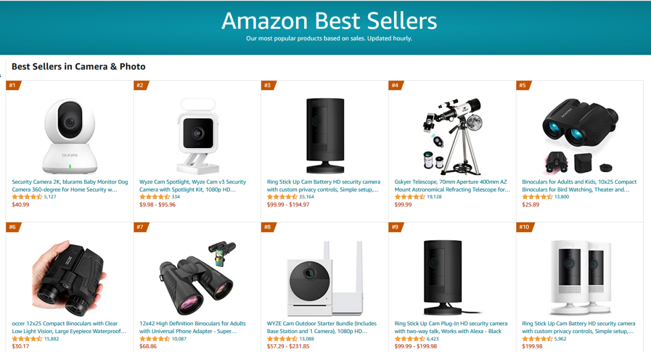
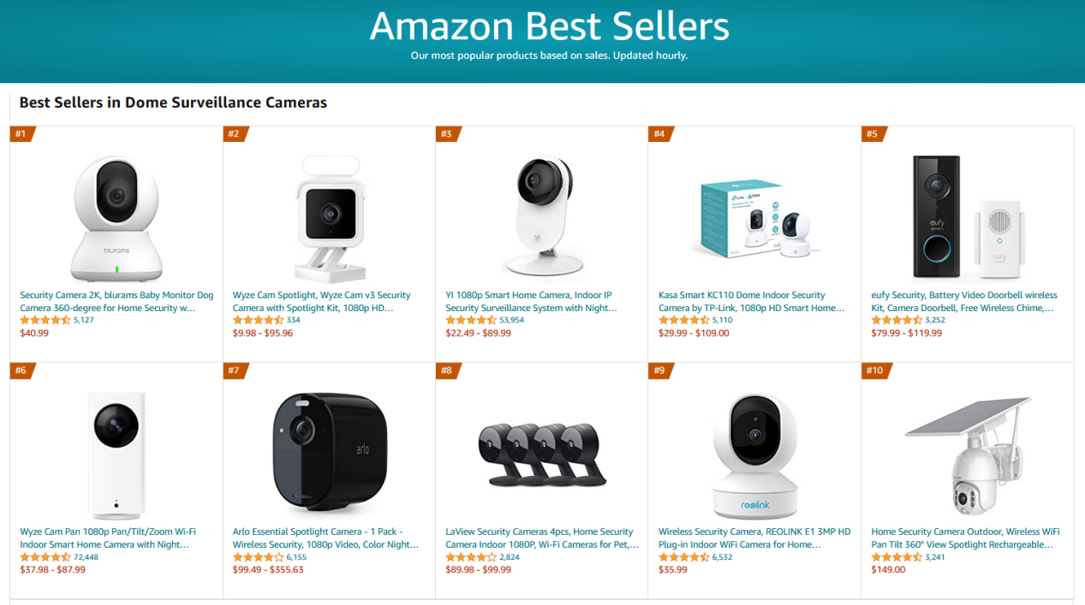
#1 Best Seller on Amazon
Camera & Photo
The largest category of cameras on Amazon
Dome Surveillance Cameras

Slide 4

Blurams Smart Home Solution
Our products work together as an ecosystem via app to cover any size of houses.

Slide 5
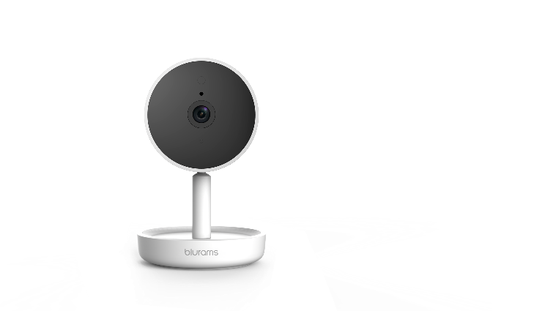
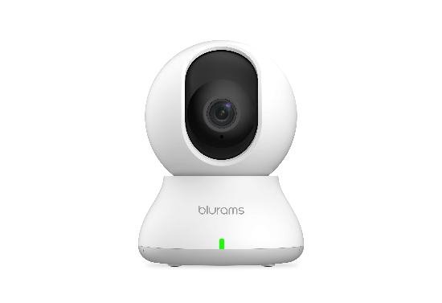
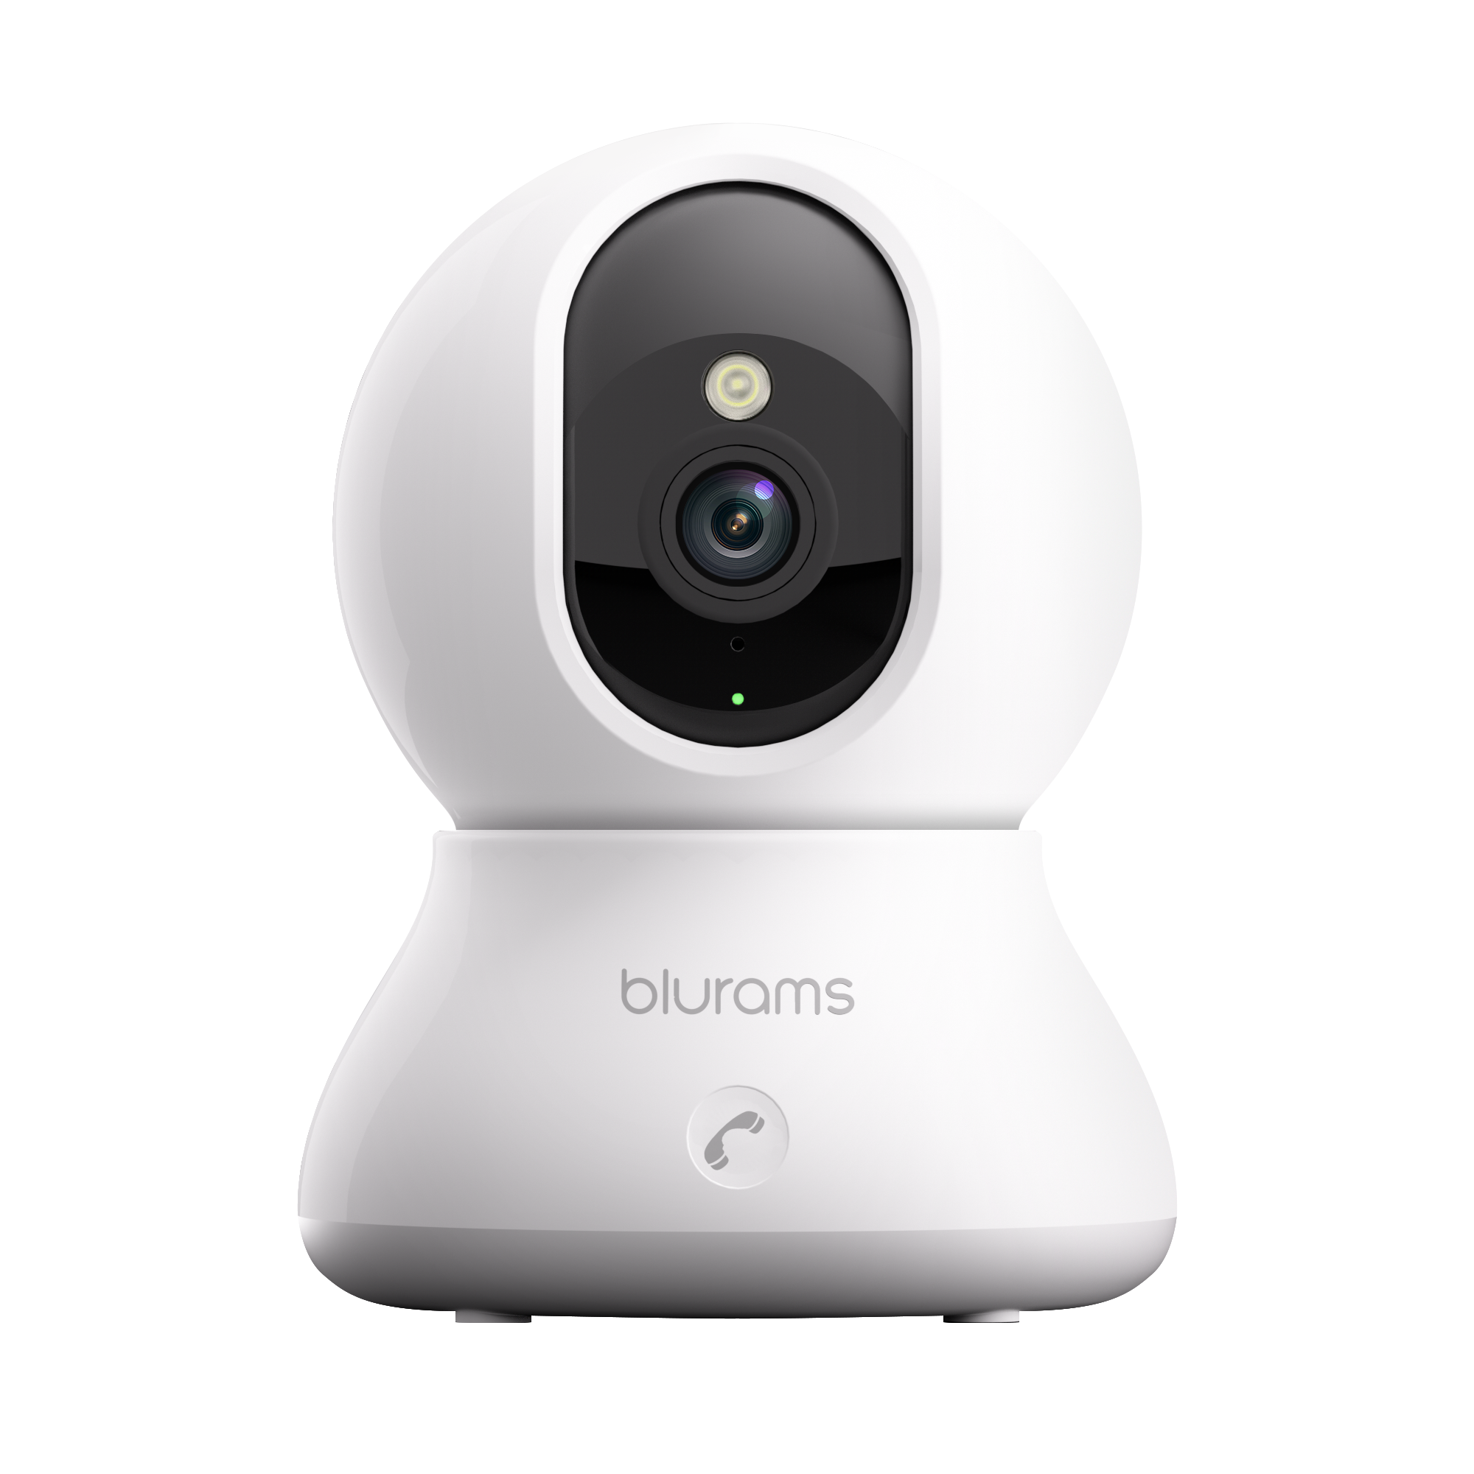
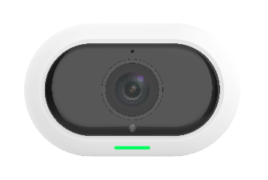
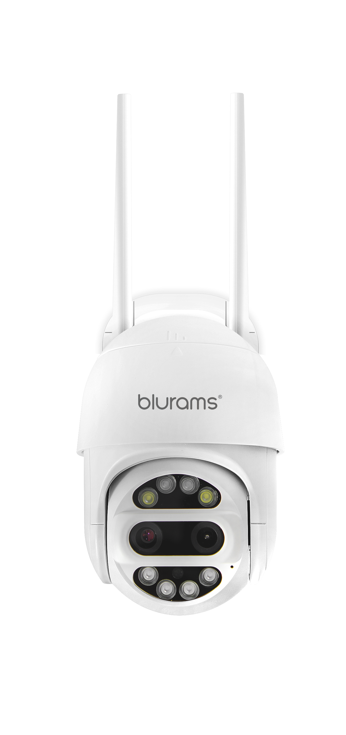
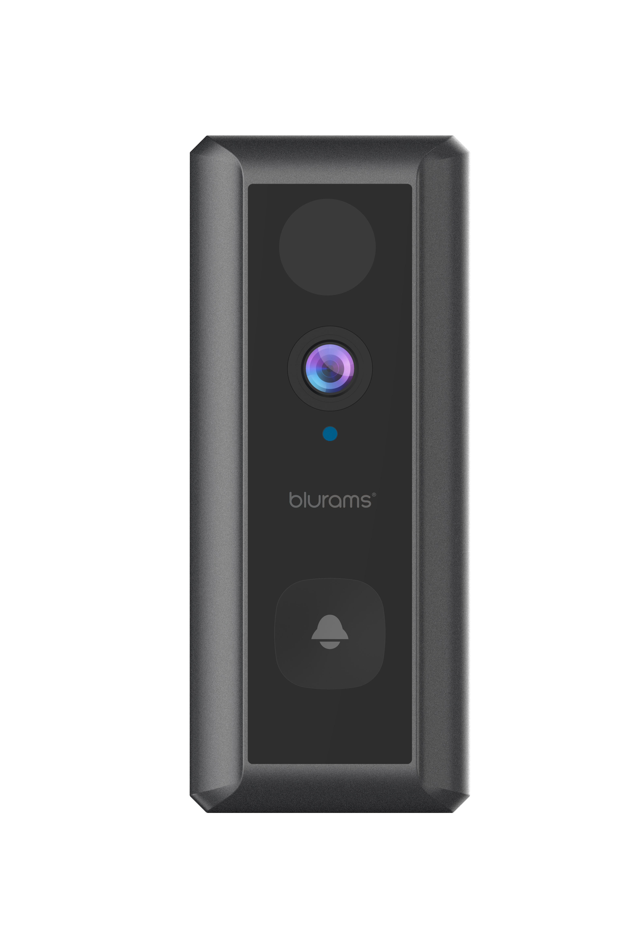
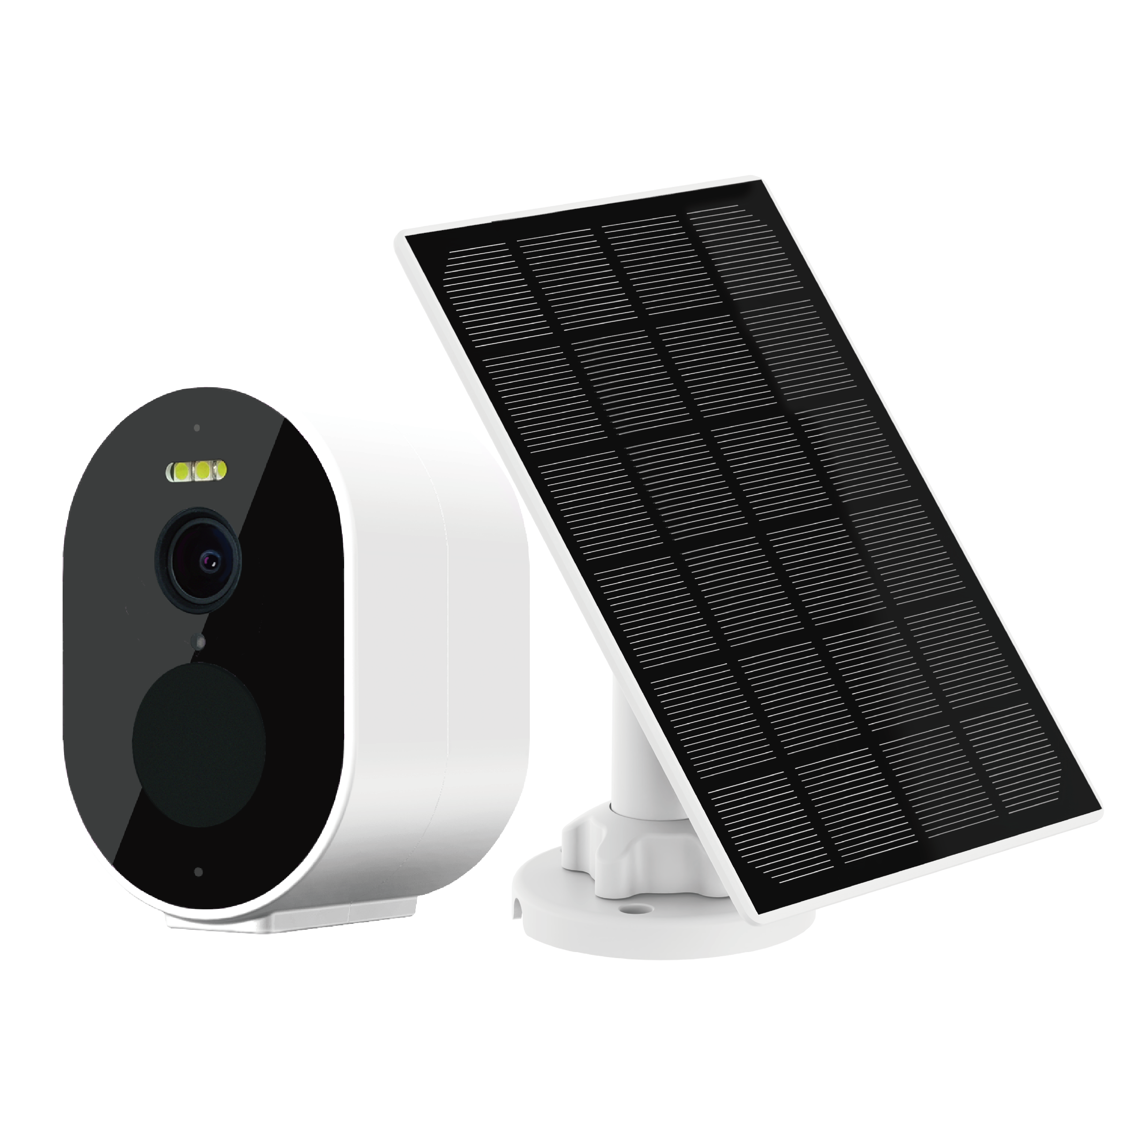
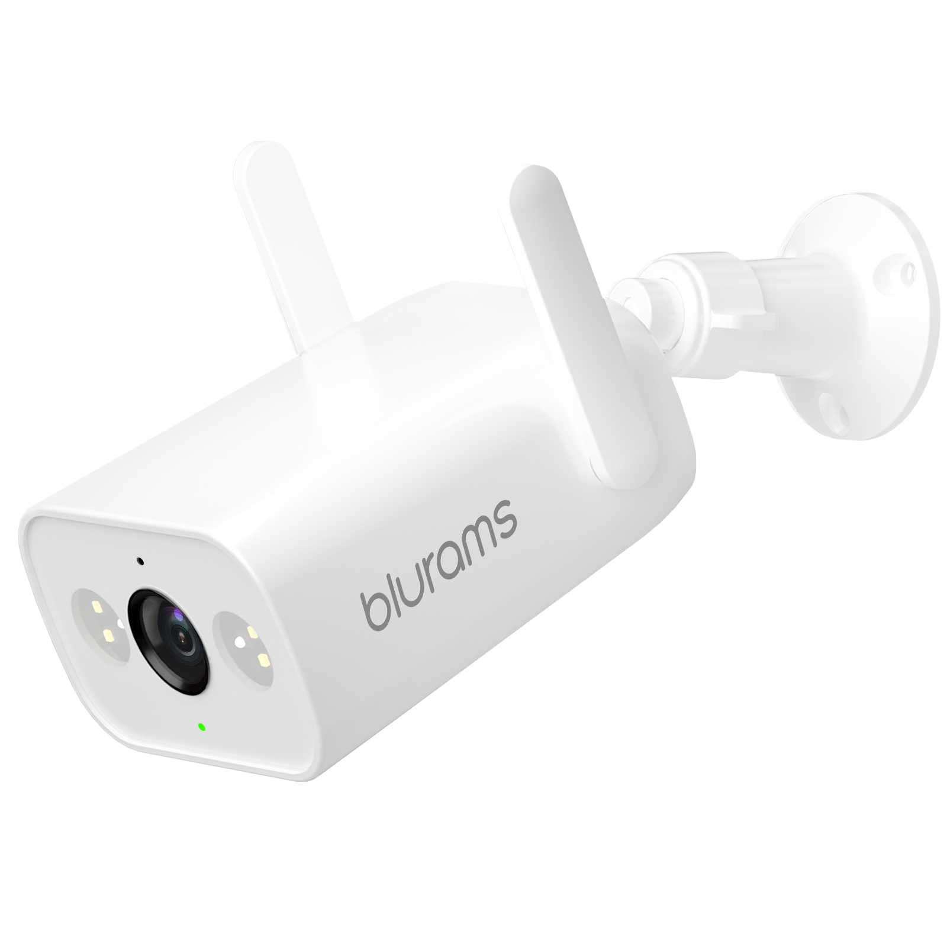
Current Product Portfolio
Blurams Dome Lite 2
Blurams Home Pro 2K
Blurams Outdoor Pro
Blurams Dome Pro 2
Blurams PTZ Dual-Lens
Outdoor Cam 3MP
Blurams Wire-Free
Camera 2K Kit
Blurams Wire-Free
Video Doorbell 2K
Blurams Outdoor Lite 4

Slide 6
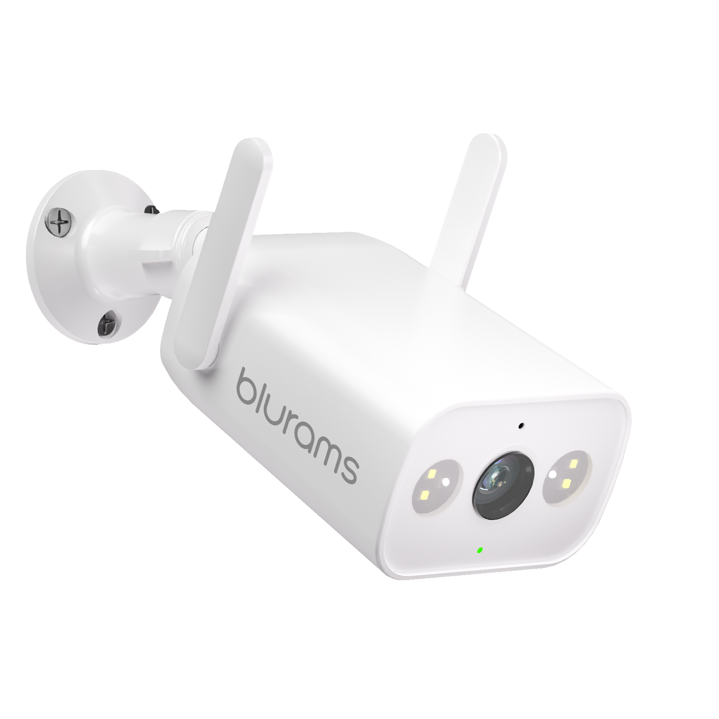














Blurams Outdoor Lite 4
Optional 24/7 Recording
Intelligent Alerts
All-Night-Long
Spotlights
Sound & Light Alarm
3MP Resolution
2-Way Audio
Wi-Fi & Ethernet Connection
Mobile & Web View
IP66
Package Detection

Slide 7
Highlights & Features
Color Night Vision with Spotlights: Built-in 4pcs white spotlights allow for great all-night color night vision, ensuring vivid details under pitch dark.
Sound & Light Alarm: Once a person is detected, the spotlights and siren will be triggered to warn off the stranger. You could also manually activate the spotlights to stop the crime before it happens.
3MP High Resolution: 4X clearer than 1080p, every detail, even when zoom in up to 4X will be perfectly reproduced with live streaming and playback.
High-Gain Dual Antennas: Built-in high-gain dual antennas enable stable 2.4G Wi-Fi connection, view smooth live stream anywhere and anytime. In addition, Ethernet cable network connection also supported.
Optional 24/7 Recording: Nonstop recording when connected to power source allows you to play complete back videos.
IP66 Certified Weather-Resistant: IP66-certified to withstand the rain, sun, heat or chill. Used to working in all kinds of harsh weathers.
Package Detection: Get instant notifications sent to your smartphone when the camera sees a package being dropped off. Enjoy peace of mind knowing your packages arrived safely.

Slide 8

Intelligent Whole House Protection
Blurams Guard: secure all your blurams cameras recordings with blurams Cloud service, using financial-industry level encryption to offer the safest storage solution.
Blurams App: view the live steaming through your mobile phone or PC web and set various functions via App. It only takes 1 minute to get connected.

Slide 9
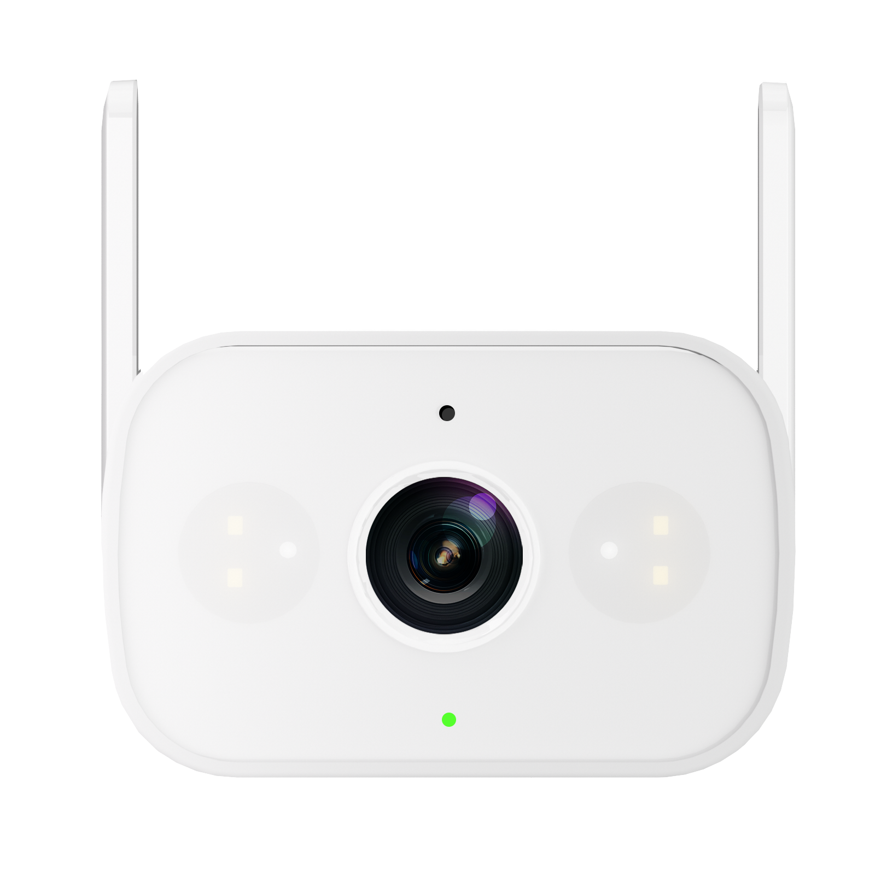
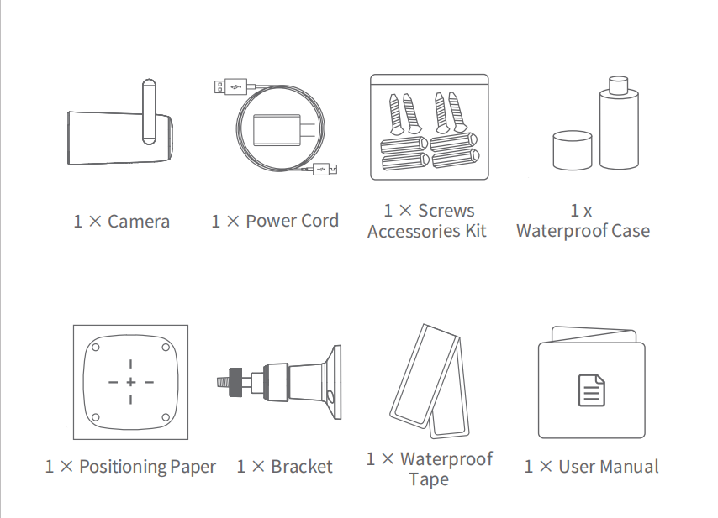
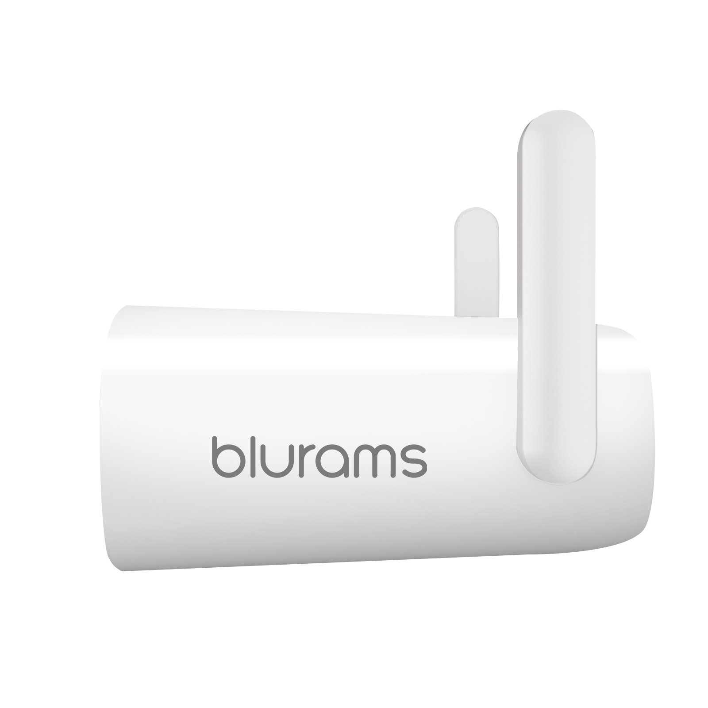
Packing List
51.9mm
79.9mm
103mm
Dimension: 103 x 79.9 x 51.9mm
Camera Weight: 166g With Box: 455g

Slide 10
Technical Specs
Functions | Blurams Outdoor Lite 4
Power Supply | DC 12V/1A Power Cord (3m Cable)
Operating Temp. | -30°C～50°C
Viewing Angle | 100°
Image/Audio Enhancing | 3D Noise Reduction, 4X Digital Zoom
Image Sensor | 1/2.8" 3MP CMOS SENSOR
Focal Length | 3.89mm
Video Resolution | 3MP High Resolution
Night Vision | 2*850nm IR LEDs, 10m/32.8ft
Alert Information | Motion, Human & Shape Detection
Microphone/Speaker | Two-Way Audio

Slide 11
Technical Specs
Functions | Blurams Outdoor Lite 4
Spotlight | 4 LEDs
 | Color Temperature: 6000K
 | Lumens: 260Lm
Local Storage | Micro SD Card (up to 128GB)
Cloud Storage | Lifetime 24h 15s Event Recording (Standard and Premium Plan Available)
Supported App | Mobile: Android/iOS (Windows Phone Not Supported) in 1 Integrated App and PC Web View
Video Coding | H.264/H.265
Wireless Standards | IEEE 802.11 b/g/n
IPsec Protocols | WPA/WPA2, WPA-PSK/WPA2-PSK

Slide 12
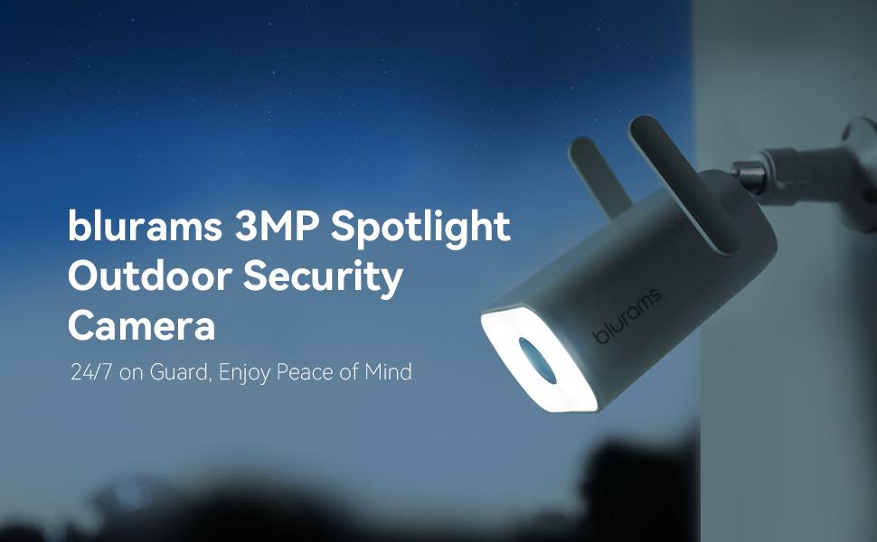

Slide 13

Living Carefree
www.blurams.com

