Slide 1
CHOETECH Products
CHOETECH--Power to The Best
CHOETECH--Power to The Best
CHOETECH POWER TO THE BEST

Slide 2
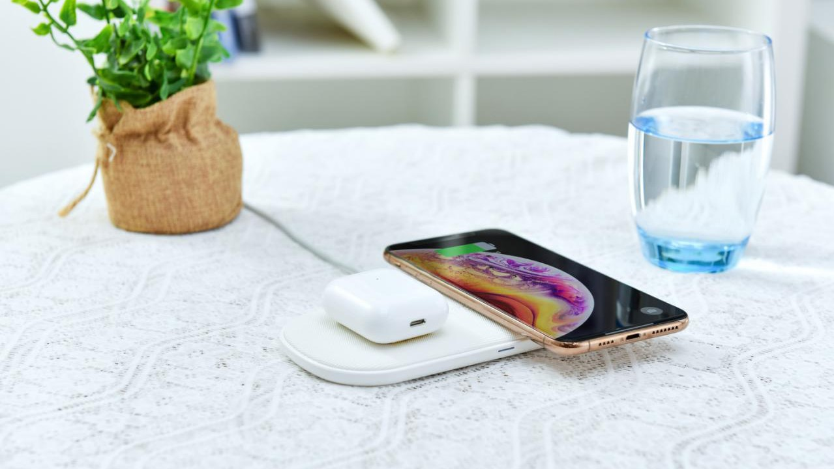
Wireless Charging Pad

Slide 3
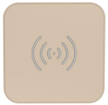
Features
1. The best-selling wireless charging product;
2. Qi certified products, four colors are available;
3. With over-charge, over-voltage, over-temperature, over-current protection;
4. Anti-slip silicone mat will protect your device from slipping off;
5. It supports three charging modes of 10W/7.5w/5W.
10W Fast Wireless Charging Pad
Model | T511-S
Material | Plastic
Interface | Micro USB
Input | 5V/2A, 9V/1.8A
Output | 10W(Compatible with 7.5W/5W)
Product Size | 91*91*8.5mm
Available Color | Black/Red/White/ Gold
Certifications | CE, RoHS, FCC, Qi, ETL, RCM , PSE
Best seller, 5000pcs/day

Slide 4
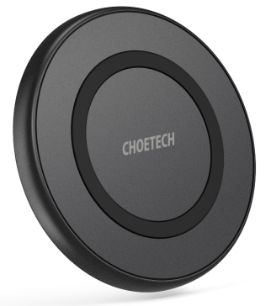
Features
1. Qi certified products;
2. Anti-slip silicone mat will protect your device from slipping off;
3. With over-charge, over-voltage, over-temperature, over-current protection;
4. It supports three charging modes of 10W/7.5w/5W.
10W Fast Wireless Charging Pad
Model | T526-S
Material | Anti-fire ABS
Interface | Micro USB
Input | 5V/2A, 9V/1.8A
Output | 10W(Compatible with 7.5W/5W)
Product Size | 87*87*9mm
Available Color | Black
Certifications | Qi,CE, RoHS, FCC, ETL, RCM, PSE
Best seller at physical stores

Slide 5
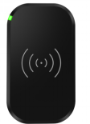
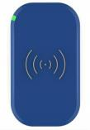
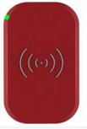
Features
1. Built with 3 coils to provide much wider charging area;
2. Qi certified products;
3. With over-charge, over-voltage, over-temperature, over-current protection;
4. Slim and light plastic pad with anti-slip rubber helps you charge your device in a safe and easy way;
5. It supports three charging modes of 10W/7.5w/5W.
10W Fast Wireless Charging Pad with 3 Coils
Model | T513-S
Material | Plastic
Interface | Micro USB
Input | 5V/2A, 9V/1.8A
Output | 10W(Compatible with 7.5W/5W)
Product Size | 120*70*10.6mm
Available Color | Black/White/Blue/Gold/Red
Certifications | Qi,CE, RoHS, FCC, ETL, RCM, PSE
Wider Charging Area

Slide 6
Features
1. The maximum output power of this wireless charger is increased to 15W;
2. Anti-slip silicone mat will protect your device from slipping off;
3. With over-charge, over-voltage, over-temperature, over-current protection;
4. Supports four charging modes of 15W/10W/7.5w/5W.
15W Fast Wireless Charging Pad
Model | T527-F
Material | Anti-fire ABS
Interface | Micro USB
Input | 5V-12V/2A
Output | 15W(Compatible with 10W/7.5W/5W)
Product Size | 87*87*9mm
Available Color | Black
Certifications | CE, RoHS, FCC, ETL, RCM, PSE

Slide 7
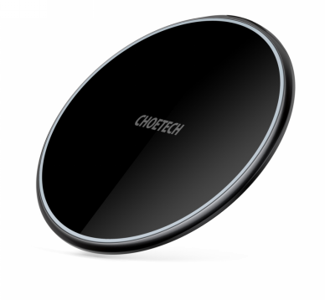
Features
1. The maximum output power of this wireless charger is increased to 15W;
2. The built-in large coil of pure copper and smart chip provide more efficient charging;
3. Premium zinc-alloy & tempered glass enable good heat dissipation;
4. Simple and smooth design, thin and light bogy, all make it easy to carry;
5. With over-charge, over-voltage, over-temperature, over-current protection.
15W Fast Wireless Charging Pad
Model | T559-F
Material | zinc-alloy & tempered glass
Interface | USB-C
Input | 5V-12V/2A
Output | 15W(Compatible with 10W/7.5W/5W)
Product Size | 100*100*6.6mm
Available Color | Black
Certifications | ETL, RCM, FCC, CE, RoHS
Power up to 15W
Brand spokesman

Slide 8
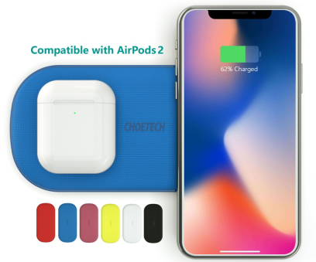
Features
1. Built-in 5 coils provide a wider charging area;
2. Charge two smartphones at the same time, compatible with AirPos 2;
3. Anti-slip PU leather surface provides sleek and modern style, also prevents your smartphone from sliding;
4. Type-C input to support high-speed input for fast wireless charging;
5. It supports three charging modes of 10W/7.5W/5W, total 18W Max;
6. With over-charge, over-voltage, over-temperature, over-current protection.
5-Coil Dual Fast Wireless Charger
Model | T535-S
Material | ABS + PU
Interface | USB-C
Input | 5V/3A, 9V/3A(Max)
Output | Total 18W Max
Product Size | 170*80*12.4mm
Available Color | Black/White/Red/Coral/Blue/Yellow
Certifications | CE, FCC, RoHS, ETL, RCM,Qi , PSE
Best seller in 2019
OEM for Verizon & Errison

Slide 9
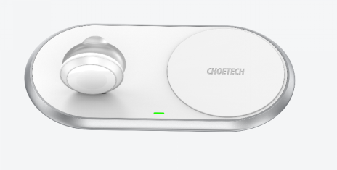
Features
1. Rapid wireless charging dock can charges one Qi-enabled phone and an Apple Watch simultaneously;
2. The anti-slip silicone pads on the bottom and surface helps keep your dock in place;
3. Surrounded by unique aluminum alloy frame with stylish and gorgeous features;
4. Foldable Apple Watch pad provides various angles to meet the visual needs of different people.
2 in 1 Fast Wireless Charger
with Stand for Apple Watch
Model | T317
Material | Zinc Alloy; Anti-fire PC; TPE
Interface | USB-C
Input | 5V-2A,9V-2A
Output | Apple Watch 5W(max)+iphone 10W(max）
Product Size | 180*92*12.5mm
Available Color | White
Certifications | MFI，QI，FCC，CE，RoHS
New Arrival

Slide 10
Wireless Charging Stand

Slide 11
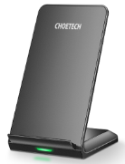
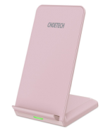
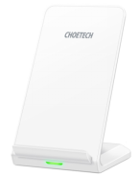
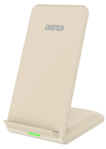
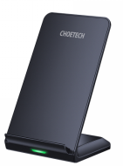
10W Fast Wireless Charging Stand
Features
1. Built-in 2 coils to allow you to charge the cellphone vertically or horizontally;
2. Provide you with more flexible choice for reading, listening to music, playing games, watching a video, etc;
3. Qi certified products. With over-charge, over-voltage, over-temperature, over-current protection;
4. It supports three charging modes of 10W/7.5W/5W.
Model | T524-S
Material | Anti-fire ABS
Interface | Micro USB
Input | 5V/2A, 9V/1.8A
Output | 10W(Compatible with 7.5W/5W)
Product Size | 121*82*75.5mm
Available Color | Black，Rose Gold，Gold，White, Dusty Blue
Certifications | CE, RoHS, FCC, Qi, ETL, RCM, PSE
Best seller

Slide 12
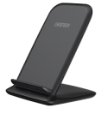
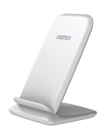
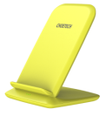
10W Fast Wireless Charging Stand
Features
1. Six colors are available, and the color matches perfectly with the iPhone XR;
2. Built-in 2 coils allow you to charge the cellphone vertically or horizontally;
3. Provide you with more flexible choice for reading, listening to music, playing games, watching a video, etc;
4. With over-charge, over-voltage, over-temperature, over-current protection;
5. It supports three charging modes of 10W/7.5W/5W.
Model | T555-S
Material | Anti-fire ABS
Interface | Micro USB
Input | 5V/2A, 9V/1.8A
Output | 10W(Compatible with 7.5W/5W)
Product Size | 118*82*76mm
Available Color | Black/White/Yellow/Blue/Red/Orange
Certifications | CE, RoHS, FCC, ETL, RCM, PSE
Best seller at physical stores

Slide 13
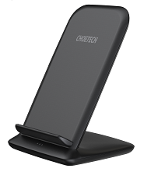
15W Fast Wireless Charging Stand
Features
1. The maximum output power of this wireless charger is increased to 15W;
2. Built-in 2 coils allow you to charge the cellphone vertically or horizontally;
3. Provide you with more flexible choice for reading, listening to music, playing games, watching a video, etc;
4. With over-charge, over-voltage, over-temperature, over-current protection;
5. It supports 4 charging modes of 15W/10W/7.5W/5W.
Model | T555-F
Material | Anti-fire ABS
Interface | Micro USB
Input | 5V-12V/2A
Output | 15W(Compatible with10W/7.5W/5W)
Product Size | 118*82*76mm
Available Color | Black/White
Certifications | CE, RoHS, FCC, ETL, RCM
Power up to 15W
Brand spokesman

Slide 14
Wireless Car Charger

Slide 15
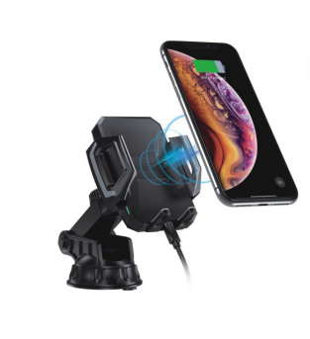
Features
1. Easy operation, just press the button at the back and locks your phone into the holder, very safe and simple;
2. The dock can be firmly fixed on surfaces, ensuring steady position;
3.The car charger adds soft silicone to the phone clamp arms and foot support, helping to securely and safely hold your phone;
4. The telescopic arm can extends for a variety of optimal angles.
10W Fast Wireless Car Charger
Model | T521-S
Material | PC+ABS
Interface | Type-C
Input | 5V/2A, 9V/1.8A
Output | 10W(Compatible with 7.5W/5W)
Phone Clamp Range | 60-102mm
Available Color | Black
Certifications | CE, FCC, RoHS, ETL, RCM
Best seller
Stable design

Slide 16
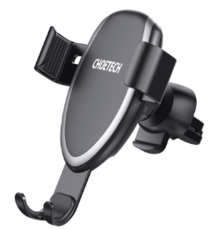
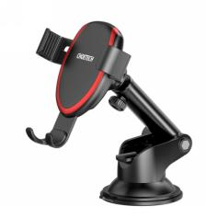
Features
1. Gravity linkage design enables you to operate with one hand, easy and simple;
2. The car charger adds soft silicone to the phone clamp arms and foot support, helping to securely and safely hold your phone;
3. Air vent mount or suction cup dock for your choice. If it's suction cup dock, the telescopic arm can be adjusted for a variety of optimal length and angles;
4. With over-charge, over-voltage, over-temperature, over-current protection.
10W Gravity Wireless Car Charger
Model | T536-S
Material | Anti-fire ABS
Interface | Micro USB
Input | 5V/2A, 9V/1.8A
Output | 10W(Compatible with 7.5W/5W)
Phone Clamp Range | 65-90mm
Available Color | Black+Silver, Black+Red
Certifications | CE, FCC, RoHS, ETL, RCM, PSE
Best seller in Europe
Gravity design

Slide 17
15W Fast Wireless Car Charger
Features
1. The maximum output power of this wireless charger is increased to 15W;
2. Adopt the new technology of current detection, intelligent identification clamping, you can operate with just one hand;
3. 360-degree rotation, air vent mount or suction cup dock for your choice;
4. The telescopic arm can be adjusted for a variety of optimal length and angles;
5. With over-charge, over-voltage, over-temperature, over-current protection.
Model | T542-S
Material | Anti-fire ABS + aluminium alloy
Interface | Type-C
Input | 5V-12V/2A
Output | 15W(Compatible with10W/7.5W/5W)
Phone Clamp Range | 58-84mm
Available Color | Black
Certifications | CE, FCC, RoHS, ETL, RCM
Power up to 15W
Current Detection

Slide 18
Wireless Charger for
Apple Watch

Slide 19
MFi Wireless Charger
for Apple Watch
Features
1. MFi certified product ensures safe charging;
2. Built in 900mAh battery capacity, it can fully charge Apple Watch twice;
3. Compatible with 1 /2 /3 /4/5 Apple Watch;
4. Pocket-size with a keychain, easy to carry;
5. With over-charge, over-voltage, over-temperature, over-current protection.
Model | T313
Material | ABS+PC
Interface | Micro USB
Capacity | 900mAh
Input | 5V/1A
Output | 5V/0.4A
Product Size | 55*55*15mm
Available Color | White
Certifications | MFi(PPID:211915-0192) CE, FCC, RoHS PSE

Slide 20
Features
1. MFi certified product ensures safe charging;
2. 5000mAh capacity can fully charge your Apple watch nearly 6 times;
3. While charging the Apple watch, it can also charge other USB devices;
4. Compatible with 1 /2 /3 /4 /5 Apple Watch;
5. Portable design allows you to put it into your travel bag easily.
MFi Power Bank for Apple Watch
Model | T315
Material | ABS+PC
Interface | Micro-USB, USB
Capacity | 5000mAh
Input | 5V/2A
Output | 5V/1A(for Apple Watch); 5V/2.1A(for USB devices)
Product Size | 100*80*60mm
Available Color | Black
Certifications | MFi, FCC, CE, RoHS, PSE

Slide 21
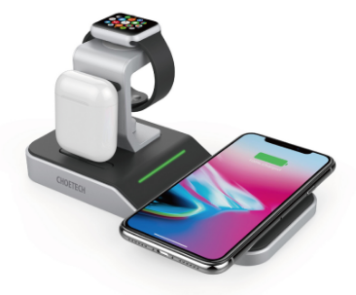
Features
1. MFi certified product ensures safe charging;
2. 4 in 1 design, can charge 4 Apple devices (mobile phone + earphone + Apple watch + other USB devices) at the same time;
3. Can provide wireless charging for Qi-enabled smartphones with charging power up to 10W;
4. With over-charge, over-voltage, over-temperature, over-current protection.
MFi 4-in-1 Multifunction Wireless Charging Dock
Model | T316
Material | ABS+aluminium-alloy
Interface | USB-A , DC , Lightning
Input | DC 12V/3A
Output | 5V/1A (USB) ; 10W(Wireless Charging); 5W(for Apple Watch); 5V/2.1A(Lightning)
Product Size | 180*85*82mm
Available Color | Silvery + black
Certifications | MFi, CE, RoHS, FCC, PSE

Slide 22
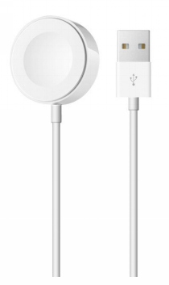
Features
1. MFi certified magnetic charging cable;
2. Combines Magsafe technology with inductive charging, offering safe charging;
3. Holds the Apple Watch securely and firmly with strong absorption and magnet;
4. Provides an original charging speed;
5. 3 feet satisfies your most daily needs, especially for travel;
6. Built-in safeguards protect your devices against excessive current, over-voltage, short-circuit and high temperature.
MFi Magnetic Charging Cable
Model | T318
Material | ABS+PC
Interface | USB-A
Input | 5V/1A (Max)
Output | 5W(Max)
Cable Length | 100mm/3.3ft
Available Color | White
Certifications | MFi, CE, FCC & RoHS
New Arrival

Slide 23
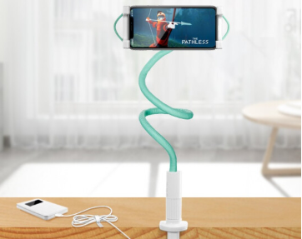
2-in-1 Phone Mount & Fast Wireless Charger
Features
1. 2-in-1 design, used as a wireless charger and mobile phone mount;
2. 360-degree free rotation, easy to watch video;
3. Good heat dissipation design;
4. Adopted high strength stretch spring to firmly clamp the phone/tablet to avoid falling off;
5. EVA + silicone pad double protection, can not only prevent sliding but also protect the desktop from scratch;
6. Earphone jack and charging jack are reserved at both ends to listen to music while charging. Phones that don't support wireless charging can also use this stand.
Model | T548-S
Material | ABS chuck, PC, silica gel, electrical components, aluminum alloy support rod, PVC, PU leather
Interface | USB-A
Input | 5V/2A, 9V/1.8A
Output | 10W(Max)
Compatible Phone Size | 4.7-7''
Available Color | White
Certifications | CE, RoHS, FCC, ETL, RCM

Slide 24
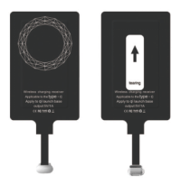
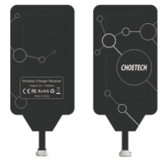
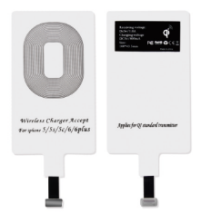
Wireless Charging Receiver
Features
1. Adopt intelligent control charging IC and WPC Ferrite of TI, to prevent your phone from overheating during charging, make your phone get charging safer and more stable;
2. Directly insert the magic tag into the moblie phone charging port to realize wireless charging;
3. Compact and lightweight without increasing additional weight to your phone .
Model | WP-IP/WP-MICRO/WP-TYPEC
Interface | Lightning/Micro USB/Type-C
Input | 5V/1A
Output | 5V/1A

Slide 25
USB Charger

Slide 26
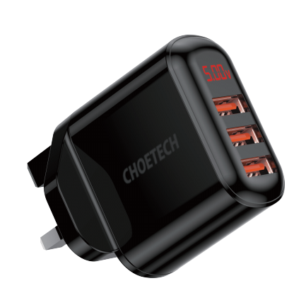
Features
1. 3 USB ports allow you to charge three devices simultaneously;
2. Digital display screen clearly shows real-time voltage and current;
3. Automatically detect and charge your device at up to 2.4A;
4. Featuring over-current, over-voltage, over-heating, over-charging and short circuit protection.
3 Port USB Wall Charger
with Digital Display
Model | Q5009
Material | Anti-fire ABS+PC, Fire rating V0
Interface | 3 x USB-A
Input | 100~240V, 50/60Hz, 0.4A Max
Each USB Output | 5V/2.4A Max
Total Output | 5V/3.4A Max
Plug Available | UK
Certifications | CE, FCC,RoHS
New Arrival

Slide 27
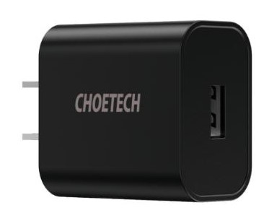
Features
1. QC3.0 fast charging technology, charging power up to 18W；
2. Built-in intelligent identification chip, it will intelligently match your device；
3. Made of 94V0 grade fireproof PC material, can resist high temperature and normal impact, ensuring long service life
4. Compatible with most phones and tablets of major brands with USB-A interface；
5. Exquisite and small, easy to carry, travel without burden.
QC3.0 18W USB Charger
Model | Q5003
Material | Anti-fire ABS+PC, Fire rating V0
Interface | USB-A
Input | AC 100-240V, 50/60Hz, 0.5A
Output | 3.6-6V~3A,6-9V~2A,9-12V~1.5A
Total Power | 18W(Max)
Plug Available | CN, US, JP, EU, AU, UK
Certifications | CE、ETL、FCC、ROHS、DOE VI、CCC PSE、SAA
Hot

Slide 28
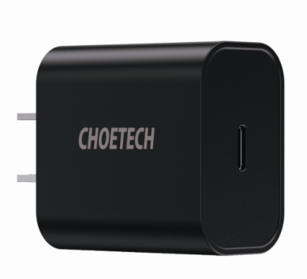
Features
1. PD3.0 fast charging technology, the maximum power is up to 18W；
2. Built-in intelligent identification chip, it will intelligently match your device;
3. Compatible with most phones and tablets of major brands with USB-C interface;
4. Made of 94V0 grade fireproof PC material, can resist high temperature and normal impact, ensuring long service life；
5. Exquisite and small, easy to carry, travel without burden.
PD 18W USB-C Charger
Model | Q5004
Material | Anti-fire ABS+PC, Fire rating V0
Interface | Type-C
Input | AC 100-240V, 50/60Hz, 0.5A Max
Output | 5V~3A; 9V~2A; 12V~1.5A
Total Power | 18W(Max)
Plug Available | CN, US, JP, EU, AU, UK
Certifications | CE、ETL、FCC、ROHS、DOE VI、CCC、 PSE、SAA
Hot

Slide 29
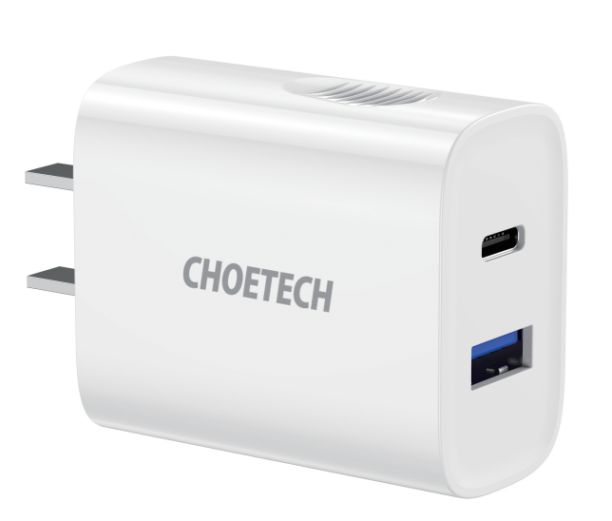
Features
1. 1 USB-A port and 1 USB-C port allow you to charge three devices simultaneously;
2. PD + QC Fast Charging, the charing power up to 18W;
3. Charge your device 50% in half an hour;
4. Anti-slip fingerprint design, easy to plug and use;
5. Featuring over-current, over-voltage, over-heating, over-charging and short circuit protection.
PD+QC 18W
2-Port Charger
Model | Q6004
Material | Anti-fire ABS+PC, Fire rating V0
Interface | USB-C; USB-A
Input | AC 100-240V; 50/60Hz; 800mA
Output | USB-A Output: DC5V-3A,9V-2A,12V-1.5A USB-C Output: DC5V-3A,9V-2A,12V-1.5A
Total Power | 18W (Max)
Certifications | CCC
Plug Available | CN

Slide 30
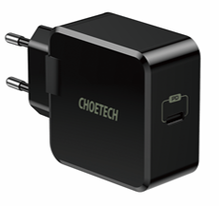
Features
1. The USB-C port with PD 3.0 technology enables to charge phones, tablets, laptops and other USB-C device at up to 30W;
2. Compact size makes it ideal for home, office and vacations;
3. Featuring over-current, over-voltage, over-heating, over-charging and short circuit protection;
4. Super premium and durable material is against daily wear and tear for long time use.
PD 30W USB-C Charger
Model | Q6005
Material | Anti-fire ABS+PC
Interface | USB-C
Input | AC100-240V, 50/60Hz, 800mA
Output | DC5V-3A,9V-3A,15V-2A,20V-1.5A
Total Power | 30W(Max)
Certifications | ETL,3C,CE,FCC,ROHS,PSE

Slide 31
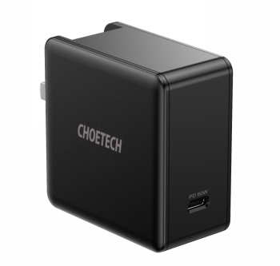
Features
1. PD3.0 fast charging technology, the maximum power output is 60W, can charge the MacBook at full speed；
2. Foldable plug gives it much smaller size, easy to carry；
3. Built-in intelligent identification chip, it will intelligently match your device;；
4. Made of 94V0 grade fireproof PC material, can resist high temperature and normal impact, ensuring long service life.
PD 60W USB-C Charger
Model | Q4004
Material | Anti-fire ABS+PC, Fire rating V0
Interface | Type-C
Input | AC 100-240V, 50/60Hz,1.5A Max
Output | DC 5V~3A, 9V~3A, 12V~3A,15V~3A,20V~3A
Total Power | 60W(Max)
Certifications | CE、ETL、FCC、ROHS、DOE VI、CCC PSE、SAA
Plug Available | CN, US, JP, EU, AU, UK

Slide 32
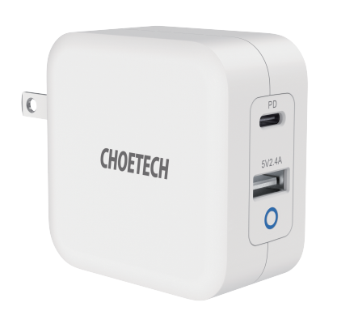
Features
1. PD 65W : Fully charge MacBook in just 2 hours; fully compatible with PD devices;
2. GaN Tech: Makes the charger smaller faster cooler and safer, greater than traditional silicon chargers;
3. Extremely Compact: 35% smaller than Apple 61W Adapter ;
4. Dual Charging: Juice up 2 devices simultaneously; USB-C and USB-A port share a total 57W output;
5. TUV Safety Certified: Built-in safeguards protect your devices against excessive current, over-heating, over-voltage, short-circuit and fire.
PD 65W GaN Mini Fast Charger
Model | Q6008
Material | Anti-fire ABS+PC
Interface | 1 x USB-C;1 x USB -A
Input | AC 100-240V 50/60Hz 1.4A (Max）
Output | USB-C: DC 5V-2.4A, 9V-3A,12V-3A,15V-3A,20V-3.25A (65W Max) USB-A: DC 5V-2.4A (12W Max)
Total Power | 65W (Max)
Protocol | PD3.0 QC3.0 Apple-2.4A
Certifications | TUV, CE, FCC, ROHS, PSE,DOC IV
New Arrival

Slide 33
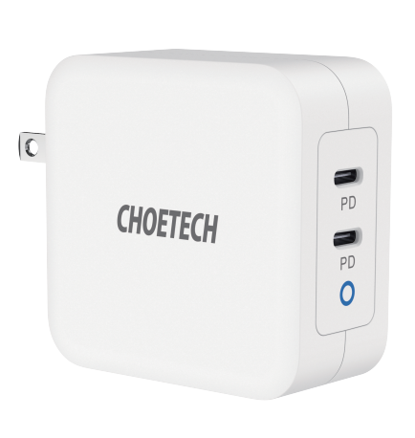
Features
1. PD 100W : Fully charge MacBook within 2 hours; fully compatible with PD devices;
2. GaN Tech: Makes the charger smaller faster cooler and safer, greater than traditional silicon chargers;
3. Super Compact: 30% smaller than Apple 96W Adapter ;
4. Dual USB-C: Quick charge 2 laptops simultaneously;
5. TUV Safety Certified: Built-in safeguards protect your devices against excessive current, over-heating, over-voltage, short-circuit and fire.
PD 100W GaN
Dual USB-C Charger
Model | PD6008
Material | Anti-fire ABS+PC
Interface | 2 x USB-C
Input | AC 100-240V 50/60Hz 2.5A（Max）
Output | USB-C 1: DC 5V-3A, 9V-3A,12V-3A,15V-3A,20V-5A(100W Max) USB-C 2: DC 5V-3A, 9V-3A,12V-3A,15V-3A,20V-5A(100W Max)
Total Power | 100W（Max）
Protocol | PD3.0 QC3.0 Apple-2.4A
Certifications | TUV, CE, FCC, ROHS, PSE, DOC IV
Available Plug | US/JP/CN/EU/UK
New Arrival

Slide 34
Features
1. Huawei SCP, FCP, QC3.0 and Samsung AFC fast charging technology, charging power up to 22.5W;
2. Compatible with most phones and tablets of major brands with universal USB-A interface;
3. Foldable plug gives it much smaller size, easy to carry;
4. Built-in protection against over-charging, over-heating and short-circuit will guard the safety of your device.
5A Super Fast Charger
Model | Q5001 (TC-035SCP)
Material | Anti-fire ABS+PC, Fire rating V0
Interface | USB-A
Input | AC 100-240V, 50/60Hz, 800mA
Output | DC 5V~3A, 9V~2A, 12V~1.5A,5V~4.5A
Total Power | 22.5W(Max)
Certifications | CCC, CE, RoHs
Plug Available | CN,EU, UK

Slide 35
Features
1. The 2-port charger with total power of 36W, supports charging 2 devices simultaneously；
2. The USB-C port is equipped with power delivery(PD) technology, capable of charging USB-C compatible devices at up to 18W;
3. QC3.0 fast charging technology, charging power up to 18W;
4. With over-charge, over-voltage, over-temperature, over-current protection；
5. Exquisite and small, easy to carry, travel without burden.
36W USB-C + QC 3.0 USB Charger
Model | PD5001
Material | Anti-fire ABS+PC
Interface | USB-A+USB-C
Input | AC 100-240V ~ 50/60Hz 1.1A Max
Output | USB-C (PD 2.0): 5V/3A; 9V/2A; 12V/1.5A 18W Max USB-A (QC 3.0): 5V/3A,9V/2A,12V/1.5A 18W Max
Total Power | 36W(Max)
Plug Available | US, EU
Certifications | CE、FCC、ROHS

Slide 36
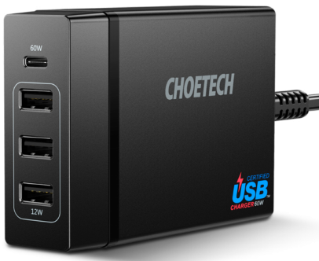
Features
1.The USB-C port with PD technology, capable of charging your Macbook at full speed and other USB-C compatible devices at up to 60W(max.);
2. The USB-C is certified USB-IF and UL(USB-IF TID:1600067, UL E472287);
3. 4 Ports pump out 72W of total power, enabling simultaneous multi-device charging.
4. With over-charge, over-voltage, over-temperature, over-current protection.
PD 72W 4-Port Desktop Charger
Model | PD72-1C3U
Interface | 1xUSB-C (PD)+ 3xUSB-A
Input | AC 100V-240V 50/60Hz 1.5A
Output | USB-C : 5V-3A,9V-3A,12V-3A,15V-3A,20V-3A USB-A*3: Total 5V-2.4A(Max) (2.4A Max Each) Total: 72W(Max)
Certifications | UL, USB-IF, CE, FCC, RoHS, VI
Plug Available | US, UK, EU

Slide 37
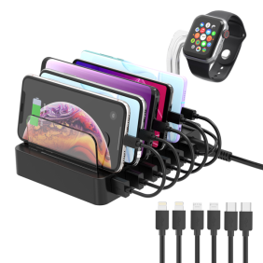
Features
1. 6 port charging station come with 6 short cables, which allows you to charge six devices simultaneously;
2. Charging speed is 4 times as fast as normal charger with a QC3.0 port;
3. Charging Station is compatible with most of USB devices;
4. Removable transparent holder design, easy to install and carry.
QC 3.0 6-Port Charing Station
Model | Q3008
Material | Anti-fire ABS + PC
Interface | 6*USB,1*DC
Input | AC 100V~240V, 50-60Hz
Output | QC3.0: 5V/3A, 9V/2A, 12V/1.5A，18W Another 5 USB Port Output: DC5V 9A,45W DC: 5V 9A,45W
Product Size | 160*122*70mm
Color | Black
Length | Power Charging Cable Length: 1.5m; USB Cable Length: 175mm

Slide 38
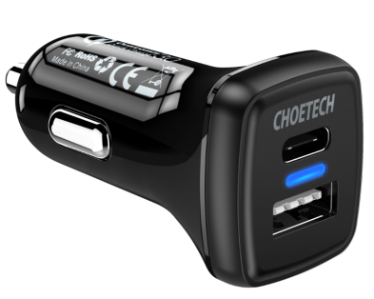
QC3.0 + PD18W Car Charger
Features
1. Features both Quick Charge 3.0 and USB-C charging ports in one charger.
2. Two ports work simultaneously with powerful total output up to 36W.
3.It will Intelligently distribute current while charging multiple digital products；
4.Small size makes it easy to carry.
Model | TC0005
Interface | USB-A, USB-C
Input | DC 12V-24V
Output | Type-C：5V-3A,9V-2A, 12V-1.5A QC 3.0：3.6-6V/2A,6-9V/2A,9-12V/1.5A
Certifications | CE, FCC, RoHs, ETL, RCM, EMC, Qualcomm® Quick Charge™ 3.0
Available Color | Black

Slide 39
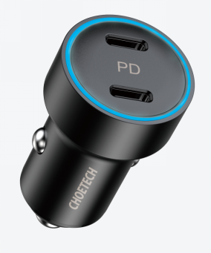
Features
1. Dual Charging: Twin USB-C PD ports allow you to charge two devices
simultaneously；
2. Highly Efficient: 18W output from each port boosts charging speed and the
total power up to 36W；
3. Universal Compatibility: Compatible with almost devices with USB-C port.
Dual PD 36W
Car Charger
Model | TC0006
Interface | USB-C, USB-C
Input | DC 12V-24V
Output | 5V=2.4A,9V=2A,12V=1.5A 5V=2.4A,9V=2A,12V=1.5A
Certifications | FCC,CE, RoHS
Protocol | PD3.0,QC3.0, QC2.0,Apple-2.4A
Material | Zinc Alloy
Available Color | Black
New Arrival

Slide 40
Features
1. High efficiency solar charger with energy conversion rate up to 24%;
2. The USB port can provide charging current up to 2.4A Max under direct sunlight；
3.Works for most USB devices such as smartphones, tablets, power banks and more；
4.Says goodbye to power sockets and embrace the power of the sun! Energy-saving and environmentally friendly;
5.Constructed with four solar panels with waterproof nylon, this solar charger offers weather-resistant outdoor durability.
14W Foldable Solar Charger
Model | SC004
Material | Waterproof Nylon +Sunpower Solar Panel
Interface | 1*USB-A
Output | 5V-2.4A (Max)
Total Power | 14W(Max)
Energy Conversion Rate | 21-24%
Product Size (Opened Size) | 660 * 148 * 31mm
Product Size (Closed Size) | 148 * 153 * 54mm
Certifications | CE, FCC & RoHS

Slide 41
Features
1. Two USB ports provide enough power and allow to charge two devices simultaneously;
2. 1/3 lighter than the same power of solar silicon. The total power increased by 1/3 in comparison with the same solar panel size;
3. PET portable folding solar plate is perfect choice for outdoor activities.
19W Foldable Solar Charger
Model | SC001
Material | Polyester canvas +Sunpower Solar Panel
Interface | 2 x USB A port
Output | 5V/2.4A
Total Power | 19W
Opened Size | 530 x 260mm
Closed Size | 260 x 160 x 17mm
Certifications | CE, PSE, RoHS

Slide 42
Features
1. Energy conversion rate up to 24%, and two individual USB ports will intelligently detect and charge two USB devices simultaneously；
2.Built-in EVA construction, along with PET + TPT material, this solar charger is weather-proof, and ultraviolet-proof；
3.Premium material makes the solar charger not easy to break off, splash-resistant, anti-scratch, durable for long-term use;
4.Pockets can hold gadgets, 2 carabiners help you attach the solar charger to backpack easily. The solar charger can be folded as a briefcase for easy carry everywhere.
22W Foldable Solar Charger
Model | SC005
Material | PET Solar Panels+Built-in EVA+Solar Cell+TPT+Waterproof Cloth
Interface | 2*USB-A
Output | USB1: 5V/2.1A(Max) USB2: 5V/2.4A(Max)
Total Power | 22W(Max)
Energy Conversion Rate | 21-24%
Product Size (Opened Size) | 245x160x30mm
Product Size (Closed Size) | 820x245x3mm
Certifications | CE, FCC, RoHS

Slide 43
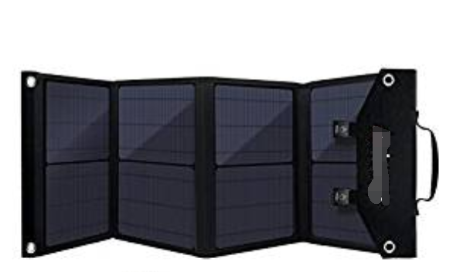
Features
1. 80W Easy-taking and folding Solar Charger;
2. PD & QC 3.0 Fast Charging with Triple-USB Ports;
3. Make from IP×4 Extra-Wateproof;
4. Perfect for outdoor activities, such as camping, cycling,biking.
80W Foldable Solar Charger
Model | SC007
Interface | 1 x DC， 1 x USB-C，2 x USB-A
Energy Conversion Rate | 20%
Output | DC: 12-18V/4.44A USB-C: PD30W USB-A1: QC3.0 18W USB-A2: 5V-2.4A
Folded Size | 410mm x 360mm x 2.7mm
Unfolded Size | 1580mmx410mmx 4.6mm
Material | PET Solar Panels+Built-in EVA+Solar Cell+TPT+Waterproof Cloth
Certifications | CE, FCC, RoHS

Slide 44
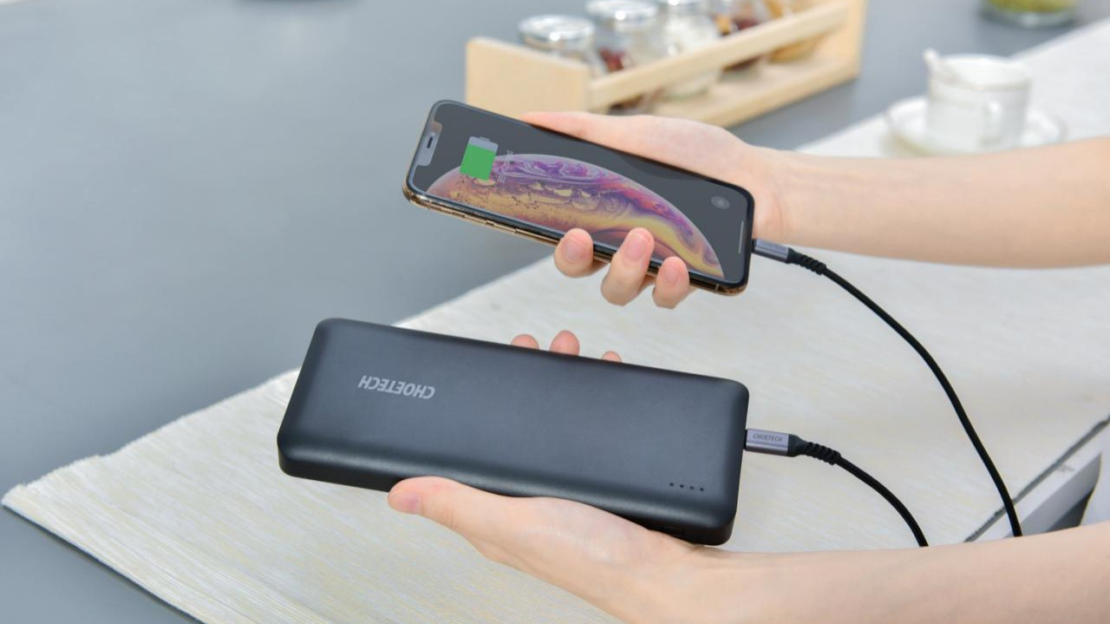
Power Bank

Slide 45
Features
1. Type-C interface supports two-way fast charging, with power up to 18W;
2. Support PD3.0+QC3.0 fast charging, can intelligently fast charge two devices simultaneously;
3. 10000mAh large capacity can charge iPhone 11 twice or Samsung Galaxy S10+ twice;
4. Smooth body with premium material makes it easier to hold in one hand, exquisite, more resistant to abrasion and scratch;
5. With over-charge, over-voltage, over-temperature, over-current protection, meet the civil aviation carrying standards, can be safely carried on the aircraft.
10000mAh PD+QC 18W Power Bank
Model | B627
Material | Anti-fire ABS + PC
Interface | Type-C, USB-A, Micro USB
Capacity | 10000mAh/37Wh
Input | Micro USB: DC5V/2A 9V/2A Type-C: DC5V/3A 9V/2A 12V/1.5A
Output | Type-C: DC5V/3A 9V/2A 12V/1.5A USB-A:DC5V/3A 9V/2A 12/1.5A Total Power: 18W
Available Color | Black
Product Size | 135*67*13mm
Certifications | FCC, CE, RoHS, PSE

Slide 46
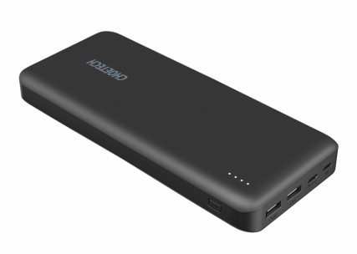
Features
1. The built-in USB-C port with Power Delivery technology allows you to fast charge your computers at up to 45W;
2. 20000mAh huge capacity can charge iPhone 11 for 3 times;
3. It can fast charge USB-A and USB-C devices at the same time;
4. With over-charge, over-voltage, over-temperature, over-current protection, meet the civil aviation carrying standards, can be safely carried on the aircraft.
20000mAh PD45W Power Bank
Model | B626
Material | Anti-fire ABS + PC
Interface | Micro USB, Type C, 2*USB-A
Capacity | 20000mAh/72Wh
Input | Micro USB: DC 5V/2A；Type C(PD 2.0): DC 5V/3A, 9V/2A, 15V/2A, 20V/1.5A 30W(Max)
Output | USB-A: DC 5V/2.4A(Single) DC 5V/3.4A(Total) Type C(PD 2.0): DC 5V/3A, 9V/3A, 12V/3A, 15V/3A, 20V/2.25A 45W(Max)
Available Color | Black
Product Size | 80*22*185mm
Protocol | USB-A Port: Apple-2.4A; Type C Port: PD 2.0
Certifications | CE, FCC, RoHS, TUV

Slide 47
High Definition Adapter & Cable

Slide 48
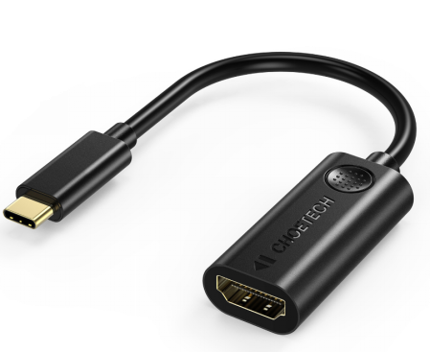
Features
1. Gold-plated connector, it supports the resolution up to 4K (3840x2160) at 60Hz;
2. Perfectly works with USB-C port devices with DP Alt mode;
3. Support video and audio output; Mirror mode and extend mode are available;
4. Lightweight and portable, plug and play, suitable for business and travel use.
USB-C to HDMI Adapter
Model | HUB-H04
Material | PVC Shell + Gold-plated Connector
Interface | USB Type-C,HDMI
Resolution | 4K(3840x2160)@60Hz
Protocol | DP Alt Mode
Available Color | Black
Certification | CE, FCC & RoHS

Slide 49
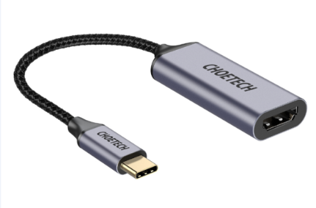
Features
1. Braid shielding+gold-plated connector+aluminum housing ensures maximum conductivity and durability;
2. The cable supports resolutions up to 4Kx2K(3840x2160) @60Hz;
3. Perfectly works with USB-C port devices with DP Alt mode;
4. Support video and audio output; Mirror mode and extend mode are available;
5. Lightweight and portable, plug and play, suitable for business and travel use.
USB-C to HDMI Adapter (Coaxial Cable)
Model | HUB-H10
Material | Braid Shielding+Gold-plated Connector+Aluminum Housing
Interface | USB C, HDMI
Resolution | 4K(3840x2160)@60Hz
Protocol | DP Alt Mode
Available Color | Space Gray
Cable Length | 0.2m
Certification | CE, FCC & RoHS

Slide 50
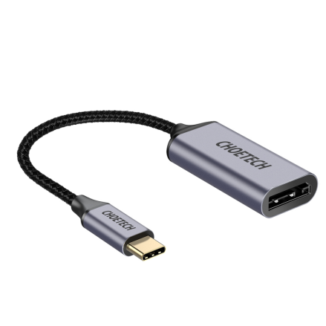
Features
1. Braid shielding+gold-plated connector+aluminum housing ensures maximum conductivity and durability;
2. The cable supports resolutions up to 4Kx2K(3840x2160) @60Hz;
3. Perfectly works with USB-C port devices with DP Alt mode;
4. Support video and audio output; Mirror mode and extend mode are available;
5. Lightweight and portable, plug and play, suitable for business and travel use.
USB-C to DisplayPort Adapter
(Coaxial Cable)
Model | HUB-H11
Material | Braid shielding+gold-plated connector+aluminum
Interface | USB Type-C, DisplayPort
Resolution | 4Kx2K(3840x2160)@60Hz
Protocol | DP Alt Mode
Cable Length | 0.2m
Available Color | Space Gray
Certification | CE, FCC & RoHS

Slide 51
Features
1. Support USB 3.1 data transfer rate of up to 5Gbps for 10/100/1000 Mbps Ethernet networks;
2. Perfectly works with USB-C port devices with DP Alt mode;
3. Lightweight and portable, plug and play, suitable for business and travel use.
USB C to RJ45 Adapter
Model | HUB-R01
Material | Plastic case, nickel-plated connector
Interface | USB 3.1 Gen 1 Type-C, RJ45
Network Speed | 10M/100/1000Mbps
Protocol | DP Alt Mode
Available Color | Black
Certification | CE, FCC & RoHS

Slide 52
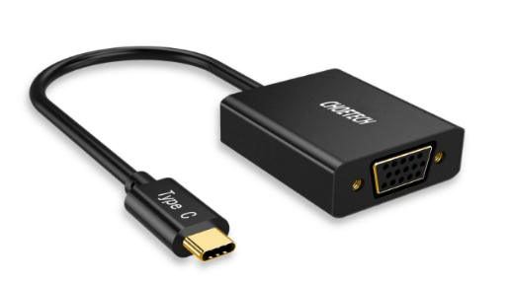
Features
1. VGA video resolution support up to 1920 x 1200 and 1080p (Full HD) for compatibility with most displays, monitors and projectors with VGA;
2. Perfectly works with USB-C port devices with DP Alt mode;
3. Support video and audio output; Mirror mode and extend mode are available;
4. Lightweight and portable, plug and play, suitable for business and travel use.
USB-C to VGA Adapter
Model | HUB-V01
Material | Aluminum Alloy Shell + Gold-plated Connector
Interface | USB Type-C, VGA
Resolution | 1080p@60Hz, backward compatible with 1080p@30Hz, 720p
Protocol | DP Alt Mode
Available Color | Black
Certification | CE, FCC & RoHS

Slide 53
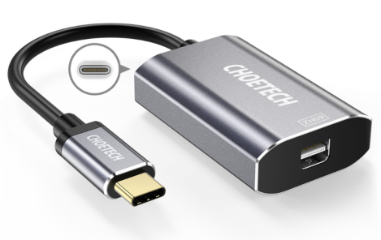
Features
1. Gold-plated connector+aluminum shell make it corrosion-resistant and durable;
2. Supports resolutions up to 4Kx2K(3840x2160) @60Hz;
3. PD charging port supports 60W maximum power, providing a long-term viewing experience;
4. Perfectly works with USB-C port devices with DP Alt mode;
5. Lightweight and portable, plug and play, suitable for business and travel use.
USB-C to Mini DP Adapter
Model | HUB-M06
Material | Gold-plated connector+aluminum shell
Interface | USB C, Mini DP, USB-C PD
Charging Speed | PD 60W(Max)
Resolution | 4K(3840x2160)@60Hz
Protocol | DP Alt Mode
Available Color | Siliver
Certification | CE, FCC & RoHS

Slide 54
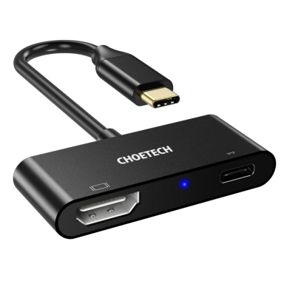
Features
1. Supports resolutions up to 4Kx2K(3840x2160) @60Hz;
2. USB-C port delivers up to 20V/3A (PD 60W) power for your devices while displaying video;
3. Perfectly works with USB-C port devices with DP Alt mode;
4. Support video and audio output; Mirror mode and extend mode are available;
5.Lightweight and portable, plug and play, suitable for business and travel use.
USB-C to HDMI + PD Adapter
Model | HUB-M03
Material | Aluminum Alloy Shell + Gold-plated Connector
Interface | USB Type-C, HDMI, USB Type-C PD(Female)
Charging Speed | 20V/3A (PD 60W Max)
Resolution | 4K(3840x2160)@60Hz
Protocol | DP Alt Mode
Available Color | Black
Certification | CE, FCC & RoHS

Slide 55
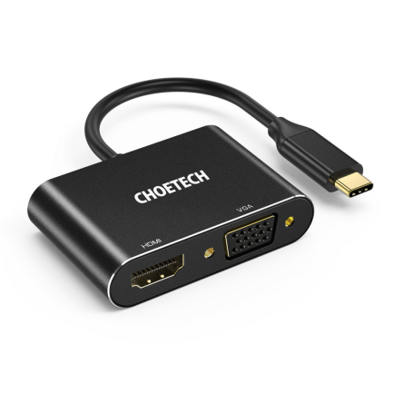
Features
1. HDMI port can provide maximum resolution up to 4K@30Hz;
2. VGA port can provide maximum resolution up to 1080p@60Hz;
3. Support HDMI and VGA output video at the same time;
4. Perfectly works with USB-C port devices with DP Alt mode.
USB-C to HDMI + VGA Adapter
Model | HUB-M17
Material | Aluminum Alloy Shell + Gold-plated Connector
Interface | USB-C, HDMI, VGA
Resolution | HDMI: 4K@30Hz VGA: 1080p@60Hz
Available Color | Black
Protocol | DP Alt Mode
Certification | CE, FCC & RoHS

Slide 56
Features
1. Multifunction adapter, support HDMI, Aux, USB2.0 data transfer, USB-C PD charging;
2. HDMI resolution is up to 4K@60Hz(only 2K@60Hz are available on 2018 iPad Pro);
3. USB-C port can provide maximum charging power up to 60W;
4. Perfectly works with USB-C port devices with DP Alt mode;
5. LED indicator light display, convenient and intelligent;
5. Light and portable, very suitable for iPad and mobile phone users.
4-In-1 USB-C to HDMI Adapter
Model | HUB-M13
Interface | Type-C Male, Type-C Female, HDMI, Audio, USB-A
Material | Aluminium alloy+ABS
HDMI Resolution | 4K@60Hz
Data Transmission(USB 2.0) | 480 Mbps
Type-C（PD 3.0) | Charging Speed: 60W(Max) Data Transmission: 480Mbps
Protocol | DP Alt Mode
Certification | CE, FCC & RoHS
Support system | iOS 12 ,Apple OS X Yosemite、 Apple OS EI Capitan、Windows 10、 Google Chrome OS, etc

Slide 57
Features
1. Small size, can connect up to 3 USB devices and a network cable at the same time;
2. USB 3.0 data transmission speed up to 5Gbps, backwards compatible with usb2.0/1.1;
3. RJ45 port can provide up to 1Gbps ultra-high network speed, stable and fast;
4. Perfectly works with USB-C port devices with DP Alt mode.
4-In-1 USB-C to RJ45 Adapter
Model | HUB-U02
Material | Aluminum Alloy Shell + Gold-plated Connector
Interface | USB C, 3xUSB A, RJ45
Data Transmission(USB-A) | 5Gbps
Network Speed | 1Gbps
Protocol | DP Alt Mode
Available Color | Black
Certification | CE, FCC & RoHS

Slide 58
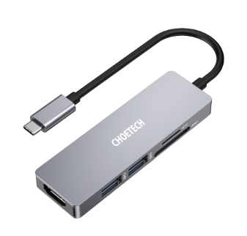
Features
1. Multifunction adapter, support HDMI, USB3.0 data transmission, SD/TF card;
2. HDMI supports maximum resolution up to 4k@30Hz;
3. Support dual USB 3.0 output, data transmission speed up to 5Gbps;
4. Support TF/SD card;
5. Perfectly works with USB-C port devices with DP Alt mode.
5-In-1 USB-C to HDMI Adapter
Model | HUB-M18
Material | Aluminum Alloy Shell
Interface | 1xHDMI, 2xUSB 3.0, 1xSD, 1xTF, 1xUSB-C Male
Data Transmission(USB-A) | 5Gbps
HDMI Resolution | 4k@30Hz
Protocol | DP Alt mode
Available Color | Silver
Certification | CE, FCC & RoHS

Slide 59
Features
1. Specifically designed for MacBook Pro 2019/2018/2017/2016 13 inches
and 15 inches, MacBook Air 2019/2018.
2.7 in 1: Including 2 USB-C and 2 USB 3.0 ports, a HDMI port, a Micro SD card reader and a SD card reader .
3. USB-C Port 1: Support super speed data transfer of up to 5Gbps (5120Mbps).
4. USB-C Port 2: Thunderbolt 3 mode supports up to 100W power delivery (PD) and 40Gbps data transfer.
5. HDMI Port: 4K HD video transfer for excellent game/movie/football match visual experience.
7-In-1 USB-C Multiport Adapter
Model | HUB-M14
Material | Aluminum Alloy
Interface | Male: 2*USB-C; Female: HDMI, TF, SD, 2*USB-C, 2*USB 3.0
Resolution | HDMI: 4K@30Hz
USB 3.0 | 5Gbps(Max.)
USB-C | Thunderbolt 3 Mode: Support 40 Gbps, 5K 60Hz, PD 87W USB-C Mode: Support 5Gbps data, PD 87W
Available Color | Space Grey
Protocol | DP Alt Mode
Certification | CE, FCC & RoHS

Slide 60
Features
1. Massive Expansion: Transform 1 USB-C port into 1 4K HDMI, 1 VGA, 3 USB 3.0, 1 SD, 1 micro SD , 1 Ethernet and 1 USB-C PD port.
2. PD 100W Power: USB-C PD port supports 100W pass-through PD charging.
3. HDMI and VGA Port: Easy to extend the display to an external monitor.
4. Instant Internet: Access reliable 1 Gbps internet, wherever there is an Ethernet connection.
5.3 x USB 3.0 Port: Up to 5 Gbps SuperSpeed data speeds let you transfer an HD movie in seconds.
9-In-1 USB-C Multiport Adapter
Model | HUB-M15
Material | Aluminum Alloy
Interface | USB-C, HDMI, VGA, USB3.0 x 3, RJ45, SD Card Reader, TF Card Reader, USB-C PD Port
Resolution | HDMI: 4K@30Hz VGA: 1080p@60Hz HDMI and VGA output simultaneously: 1080p@60Hz
Internet speed | 1000Mbps
USB-C PD | 100W(max)
Available Color | Space Grey
Protocol | DP Alt Mode
Certification | CE, FCC & RoHS

Slide 61
Thunderbolt 3 to Dual HDMI Adapter
Features
1. Thunderbolt 3 certified.;
2. Bandwidth supports up to 40Gbps;
3. Dual video output with resolutions up to 3840 x 2160@60Hz.
Model | HUB-H07
Material | PVC cable + aluminum alloy housing
Interface | USB C, 2 x HDMI
Resolution | Up to 4K@60Hz
Data Transfer Rate | 40Gbps
Available Color | Black
Certification | Thunderbolt 3, CE, FCC & RoHS
Cable Length | 254mm

Slide 62
Thunderbolt 3 to Dual DP Adapter
Features
1. Thunderbolt 3 certified.;
2. Bandwidth supports up to 40Gbps;
3. Dual video output with resolutions up to 3840 x 2160@60Hz.
Model | HUB-D03
Material | PVC cable + aluminum alloy housing
Interface | USB C, 2 x DP
Resolution | Up to 4K@60Hz
Data Transfer Rate | 40Gbps
Available Color | Black
Certification | Thunderbolt 3, CE, FCC & RoHS
Cable Length | 254mm

Slide 63
Features
1. Plug and Play, no adapter required;
2. Supports resolutions up to 4Kx2K(3840x2160) @60Hz;
3. Support video and audio output; Mirror mode and extend mode are available;
4. Gold-plated connector on both sides which inhibits corrosion, and ensures maximum conductivity;
5. Perfectly works with USB-C port devices with DP Alt mode.
USB-C to HDMI Cable
Model | CH0019
Material | PVC (cable + shell) + Gold-plated Connector
Interface | USB Type-C, HDMI
HDMI Resolution | 4Kx2K(3840x2160) @60Hz
Cable Length | 1.8m
Protocol | DP Alt Mode
Available Color | Black, White
Certification | CE, FCC & RoHS

Slide 64
Features
1. Plug and Play, no adapter required;
2. Nylon braided cable and gold-plated connector, so the cable is wear-resistant, services a super long life;
3. Supports resolutions up to 4Kx2K(3840x2160) @60Hz;
4. Support video and audio output; Mirror mode and extend mode are available;
5. Perfectly works with USB-C port devices with DP Alt mode.
USB-C to HDMI Cable
Model | CH0021
Material | Aluminum Housing + Nylon Braided Cable + Gold-plated Connector
Interface | USB Type-C Male, HDMI Male
HDMI Resolution | 4K(3840x2160)@60Hz
Cable Length | 2m
Protocol | DP Alt Mode
Available Color | Gray+Black
Certification | CE, FCC & RoHS

Slide 65
Features
1. Plug and Play, no adapter required;
2. Supports resolutions up to 4Kx2K(3840x2160) @60Hz;
3. USB-C port delivers up to 20V/3A (PD 60W) power for your devices while displaying video;
4.Support video and audio output; Mirror mode and extend mode are available;
5. Perfectly works with USB-C port devices with DP Alt mode.
USB-C to HDMI + PD Cable
Model | XCH-M180
Material | Aluminum Housing + Gold-plated Connector
Interface | USB C Female, HDMI, USB C Male
HDMI Resolution | 4Kx2K(3840x2160) @60Hz
USB C Output | 20V/3A ( PD60W)
Cable Length | 1.8m
Protocol | DP Alt Mode
Available Color | Gray
Certification | CE, FCC & RoHS

Slide 66
Features
1. Supports resolutions up to 4K@30Hz. Plug and Play, no adapter required;
2. 3m length to satisfy your various needs;
3. Support video and audio output; Mirror mode and extend mode are available;
4. Gold-plated connector on both sides which inhibits corrosion, and ensures maximum conductivity;
5. Perfectly works with USB-C port devices with DP Alt mode.
USB-C to HDMI Cable
Model | XCH-0030
Material | PVC+Gold-plated connector
Interface | USB-C, HDMI
HDMI Resolution | 4K@30Hz
Cable Length | 3m
Protocol | DP Alt Mode
Color | Black
Certification | CE, FCC & RoHS

Slide 67
Features
1. Plug and Play, no adapter required;
2. Supports resolutions up to 4Kx2K(3840x2160) @60Hz;
3. Support video and audio output; Mirror mode and extend mode are available;
4. Gold-plated connector on both sides which inhibits corrosion, and ensures maximum conductivity;
5. Perfectly works with USB-C port devices with DP Alt mode.
USB-C to DisplayPort Cable
Model | XCP-1801
Material | PVC + gold-plated connector
Interface | USB Type-C; DP
HDMI Resolution | 4K*2K(3840*2160) @60Hz
Cable Length | 1.8m
Protocol | DP Alt Mode
Available Color | Black
Certification | CE, FCC, RoHS

Slide 68
Features
1. 32.4 Gbps bandwidth allows you to enjoy the games in high resolution and with lightning-fast refresh rates;
2. Supports up to 8K(7680x4320) @ 60Hz Resolution;
3. 165Hz refresh rate reduces flicker to give you a really comfortable and smoother gaming experience;
4. HDR Provides more dynamic range and images detail than normal images;
5. High-intensity Signal Protection.
8K DisplayPort Cable
Model | XDD01
Interface | 2 x DisplayPort
Resolution | Up to 8K(7680 x 4320) @ 60Hz
Bandwidth | 32.4Gbps
Refresh Rate | 8K(7680x4320) @ 60Hz, 4K(3840 x 2160) @ 144Hz, 2K(2560x1440) @165Hz
Presell

Slide 69
Features
Plug and Play, no adapter required;
Support resolutions up to 4Kx2K(3840x2160)@60Hz;
3. Support video and audio output; Mirror mode and extend mode are available;
4. Gold-plated connector on both sides which inhibits corrosion, and ensures maximum conductivity;
5. Perfectly works with USB-C port devices with DP Alt mode.
USB C to Mini DisplayPort Cable
Model | XCM-1501
Material | USB C, Mini DisplayPort
Interface | PVC+Gold-plated connector
Mini DisplayPort Resolution | 4Kx2K(3840x2160)@60Hz
Cable Length | 1.8m
Protocol | DP Alt Mode
Available Color | Black
Certification | CE, FCC, RoHS

Slide 70
Features
This Thunderbolt 3 active cable has been tested to abide by the Thunderbolt standards;
Transfer data at up to staggering speed of 40 Gbps between two Thunderbolt devices ;
Deliver up to 100W of power delivery to charge your Thunderbolt devices;
Supports dual full 4K@60 Hz displays or even a 5K display when used with compatible systems and Thunderbolt 3 accessories.
Thunderbolt 3 Active Cable
Model | A3006
Interface | 2 x Thunderbolt 3 Port
Material | PVC + nickel-plated connector
Transfer Speed | 40Gbps
Output | 5A/20V 100W (Max)
Video Output | Up to dual 4K@60Hz displays or a 5K display
Length | 2m
Certification | CE, FCC, RoHS, Thunderbolt 3

Slide 71
Features
Thunderbolt certified, tested to abide by the Thunderbolt standards.
Supports 40Gbps data transfer speedswhich four times faster than standard USB-C cables.
40Gbps bandwidth supports dual full 4K @60Hz displays or even a 5K display when used with compatible systems and Thunderbolt 3 accessories.
Thunderbolt, USB & DisplayPort Alt Mode compatible.
(Important Note: Passive Thunderbolt 3 cable support native DP alternate mode and USB3.1 Gen1 & Gen2 mode)
Thunderbolt 3 Passive Cable
Model | A3009
Material | PVC + nickel-plated connector
Interface | 2 x Thunderbolt 3
Power Output | 20V/5A
Video Output | Single Monitor at 5K@60Hz Dual Monitors at 4K@60Hz
Length | 0.8m
Transfer Speed | 40Gbps
Certification | CE, FCC, RoHS, Thunderbolt 3

Slide 72
Charge & Sync Cable

Slide 73
Features
1. Apple MFi certified, the output current of this cable is 2.4A(Max)；
2. It works with all devices with lightning port；
3. The cable can charge Apple devices at full speed, also provide data transmission with up to 480Mbp, not bothered by upgrading;
4. Designed with TPE shell and Tinplate shield, this cable is flexible and durable.
MFi USB-A to Lightning Cable
Model | IP0026/IP0027
Interface | USB A, Lightning
Material | TPE Shell+Tinplate Shield
Available Color | Black, White
Output | 5V/2.4A
Data Transmission | USB2.0/480Mbps
Cable Length | 1.2m/1.8m
Certifications | MFi, CE, FCC, RoHS

Slide 74
Features
1.Apple MFi certified, the output current of this cable is 2.4A(Max)；
2.Micro USB and Lightning [MFi Certified] 2 in 1 combo design;
3. The cable can charge devices at full speed, also provide data transmission with up to 480Mbp, not bothered by upgrading；
4. Reinforced aluminum housing and nylon braided shielding can withstand daily wear and tear.
MFi 2-In-1 Charging Cable
Model | IP0028
Interface | USB A, Lightning, Micro
Material | Nylon Braided Protective Layer+Aluminum Housing
Available Color | Black
Output | 5V/2.4A
Data Transmission | USB2.0/480Mbps
Cable Length | 1.2m
Certifications | MFi, CE, FCC, RoHS

Slide 75
Features
1.Apple MFi certified, the output current of this cable is 2.4A(Max);
2.3 in 1 combo design, no need to carry many cables;
3. The cable can charge most devices , also provide data transmission with up to 480Mbps;
4. Reinforced aluminum housing and nylon braided shielding can withstand daily wear and tear.
MFi 3-In-1 Charging Cable
Model | IP0030
Interface | USB-A , Lightning, Micro USB, Type-C
Material | Nylon Braided Protective Layer+Aluminum Housing
Available Color | Black
Output | 5V/2.4A
Data Transmission | 480Mbps
Cable Length | 1.2m
Certifications | MFi, CE, FCC, RoHS

Slide 76
MFi USB-C to Lightning Cable
Features
1. MFi certification, compatible with all Apple equipment;
2. USB-C connector has passed USB-IF certification, and has more than 20,000 times tests of plug and pull;
3. The transmission rate is as high as 480Mbps.
Model | IP0039
Interface | USB-C, Lightning
Material | Nylon braided
Available Color | Black
Output | 100W(Max)
Data Transmission | 480Mbps
Cable Length | 1.2m
Certifications | MFi, CE, FCC, RoHS

Slide 77
MFi USB-C to Lightning Cable
Features
1. MFi certification, support USB Power Delivery charging;
2. Adopted Apple C94, provide fast charging speed, just need 30 minutes to charge your iPhone from 0-50%;
3. The transmission rate is as high as 480Mbps;
4. 2m Extra long cable expands the using space to meet your various needs.
Model | IP0036
Interface | USB-C, Lightning
Material | TPE
Available Color | Black/White
Output | 30W(Max）
Data Transmission | 480Mbps
Cable Length | 2m
Bending Life | 15000+
Certifications | MFi, CE, FCC, RoHS

Slide 78
Features
1. PD 60W Power Delivery: Capable of charging your device up to 20V/3A (Max);
2. 480Mbps Data Sync: Easily transfer the files, video and photos from your USB-C smartphones up to 480Mbps;
3. Stronger Nylon Braided: The braided cable not only avoid the tangling but also flexible enough;
4. Compatible with all USB Type-C enabled devices;
5. 2m length available, you can lie on the couch or sofa and use your devices while it's charging.
PD 60W USB-C to USB-C Cable
Model | XCC-1003/XCC-1004
Material | Nylon braided + aluminum housing
Interface | 2*Type-C
Output | 60W(Max)
Data Transfer Speed | 480Mbps
Cable Length | 1.2m/4ft; 2m/6.6ft
Available Color | Black
Certifications | CE, FCC, RoHS

Slide 79
Features
1. Support Power Delivery charging with maximum output up to 100W;
2. USB 2.0 supports data transfer speed up to 480Mbps;
3. 2m Extra long cable expands the using space to meet your various needs;
4. Premium nylon braided with aluminum alloy housing ensures a longer service life;
5. Compatible with all USB Type-C enabled devices.
PD 100W USB-C to USB-C Cable
Model | XCC-1002
Material | Nylon braided + aluminum housing
Interface | 2*Type-C
Output | 100W(Max）
Data Transfer Speed | 480Mbps
Cable Length | 1.8m
Available Color | Siliver
Certifications | CE, FCC, RoHS

Slide 80
Features
1. High-speed Charging: Supports rapid charging currents of up to 100W;
2. Rapid Data Transfer: Transfer music, movies or files in seconds with 10Gbps speed;
3. Ultra HD Video Resolution: Enabled video resolution up to 4K @ 60Hz;
4. Gen2 2m coaxial cable has better shielding performance than twisted pair;
5. The braided cable not only tangling but also flexible enough.
USB-C 3.1 GEN 2 Cable
Model | XCC-1007
Interface | USB-C, USB-C
Material | Aluminum Alloy Housing + Nylon Braided Cable
Power Output | 100W Power Delivery
Video Output | 4K @ 60Hz
Transfer Speed | 10Gbps
Cable Length | 2m
Color | Black

Slide 81
Features
1. The USB 2.0 cable transfer data speeds up to 480 Mbps;
2. Supports nearly 3A of power output for USB Type-C devices;
3. Type-C connector is compliant with the USB IF Association Appliance;
4. Environment-friendly PVC material, no odor and not easy to age.
USB-C to USB-C Cable
Model | CC0001/CC0002/CC0003
Material | PVC
Interface | 2*Type-C
Output | 3A(Max）
Data Transfer Speed | USB 2.0 (480Mbps)
Cable Length | 0.5m/1m/2m
Available Color | Black
Certifications | CE, FCC, RoHS

Slide 82
Features
1. The USB 2.0 cable transfer data speeds up to 480 Mbps;
2. Supports 3A of power output for USB Type-C devices;
3. Built-in 56KΩ pull-up resistor can protect your devices against damage, giving you incredible safety and reliability;
4. Flexible USB Type-C cable with sturdy construction makes it stronger and more durable.
USB-A to USB-C Cable
Model | AC0001/AC0002/AC0003
Material | PVC
Interface | USB-A, Type-C
Output | 5V/3A
Data Transfer Speed | USB 2.0 (480Mbps)
Cable Length | 0.5m/1m/2m
Available Color | Black
Certifications | CE, FCC, RoHS

Slide 83
Features
1. 5A SuperCharge cable, Huawei Mate 10 can be fully charged within 1.5 hours.
2. Transmission speed up to 480 Mbps while charging speed up to 5A;
3. User-friendly design, Reversible charging port, allow you to plug in the right way every time.
4. Braided Nylon Type C Cable ensure an excellent anti-twisting & abrasion-proof.
5A Supercharge USB-C Cable
Model | AC0013
Interface | USB-A Male to Type-C Male
Output | 5V/5A 25W(Max)
Data Transfer Speed | 480Mbps
Material | Nylon Braided; Anti-fire PC
Length | 1.2m
Color | Black, Silver

Slide 84
Features
1. Enables the cable compatible with both Type C and Micro USB devices;
2. It works with most of Micro USB and Type C enabled devices;
3. Built in a 56Kohm resistor, the cable safely offers maximum 3A fast charging and HighSpeed data transmission of 480Mbps;
4. All the 3 connectors are gold-plated to provide maximum conductivity.
2-in-1 USB to Micro USB + USB-C Cable (Coiled)
Model | XAC-0012-101
Material | PVC (cable + shell) + Gold-plated Connector
Interface | USB Type-C, Micro USB
Transfer Speed | 480Mbps
Power Output | 5V/3A
Color | Black
Certifications | CE, FCC, RoHs

Slide 85
Features
1. Enables the cable compatible with both Type C and Micro USB devices;
2. It works with most of Micro USB and Type C enabled devices;
3. Built in a 56Kohm resistor, the cable safely offers maximum 3A fast charging and HighSpeed data transmission of 480Mbps;
4. All the 3 connectors are gold-plated to provide maximum conductivity.
2-in-1 USB to Micro USB + USB-C Cable (Straight)
Model | XAC-0012-102
Material | PVC (cable + shell) + Gold-plated Connector
Interface | USB Type-C, Micro USB
Transfer Speed | 480Mbps
Power Output | 5V/3A
Color | Black
Certifications | CE, FCC, RoHs

Slide 86
Features
1. Full USB 2.0 support, data transmission speed up to 480Mbps;
2. The power output up to 2.4A that can fast charge your micro usb devices;
3. This cable is PVC coated, durable yet flexible. Compact design, easy to carry;
4. Compatible with most Android & Windows phones & tablets with micro usb interface.
USB-A to Micro USB Cable
Model | AB003
Material | PVC
Interface | USB-A, Micro USB
Output | 5V/2.4A
Data Transfer Speed | USB 2.0 (480Mbps)
Cable Length | 1.2m
Available Color | White, Black
Certifications | CE, FCC, RoHS

Slide 87
Features
1. 2m USB 3.0 to USB 3.0 extension cable.
2. 5Gbps superspeed data transfer,
3. Compatible with USB Keyboard,Mouse,Flash Drive, Hard Drive,Printer, etc.
4. Corrosion-resistant gold-plated connectors maximize signal transmission for optimal transmission stability.
5. Features premium braided protective layer and solid aluminum alloy shell.
USB 3.0 Extension Cable
Model | XAA001
Interface | USB-A Male to USB-A Female
Material | Nylon braided cable + aluminum alloy shell
Data Transfer Speed | USB3.0/5Gbps
Color | Space gray
Length | 2m
Certifications | CE, FCC, RoHS

Slide 88
USB-C to 3.5mm Audio Jack Adapter
Features
1. This cable will transmit audio in stereo formation, providing fantastic yet clear sound for you;
2. Compatible with almost all digital devices with standard 3.5mm aux port;
3. Braid shielding, corrosion-resistant gold-plated connector and aluminum housing give the cable reliable performance.
Model | AUX003
Interface | USB-C; 3.5mm Male Audio Port
Material | ABS
Color | Black
Length | 15mm
New Arrival
New Arrival

Slide 89
USB to NVME Enclosure

Slide 90
Features：
1. Maximum data transfer speed can be up to 10Gbps;
2. Compatible with M-Key M.2 SSD (PCI-E & NVMe based), be fit for the size of 2230 / 2242 / 2260 / 2280;
3. The latest technology USB 3.1 Type-C GEN 2 is applied;
4. Made of premium material that is good for heat dissipation.
USB 3.1 Type-C GEN 2 to NVMe M.2 SSD Enclosure
Model | PC-HDE16
Material | UV + ABS
Interface | Type-C; M-key M.2
Transfer Speed | 10Gbps(Max)
Support SSD Capacity | 2TB (Max)
Support SSD Protocol | M.2/NVM2 M Kye,B+M Key (PCIE based)
Color | Space Gray
Support SSD Size | 22x30,22x42,22x60,22x80mm

Slide 91
Features
1. Adjustable Design: Easily adjust the angle (5°~45°) to find the best viewing angles;
2. Universal Compatible: Compatible with 4~10 inch mobile phones or tablets;
3. Hands-free for video calling, making videos and watching movies;
4. The anti-slip silicone of dock and base help keep your holder in place.
Adjustable Phone Desk Holder
Model | H035
Product Name | Phone Desk Holder
Color | Sliver
Compatible with | Phone; Tablet
Material | Aluminium Alloy; Silicone
Suitable Size | 4-10inches mobile phone/tablets

Slide 92
Features
1. Magnetic car mount, fast docking with one hand.
2. Powerful sucker with lever.
3. Built in four powerful neodymium magnets.
4. With a 360 rotation swivel ball.
5. Reusable sticky gel pad, easy to clean.
Magnetic Car Phone Mount
Model | H010
Material | ABS + PVC + Silicone + Aluminum Alloy + Metal
Color | Black
Fits for | Smartphones, GPS

Slide 93
Universal Water-proof Bag
Highlights
1. IPX8 Certified: Superior water-resistant protection up to 98 feet (30 meters);
2. Dual swivel lock and sealable closure clipdesign;
3. Screen-touch Functionality ;
Model No. | WPC007
Material | Lightweight PVC
Compatible | ≤6 inches smartphone
Color | black/white/pink/blue

Slide 94
Universal Floating Water-proof Bag
Highlights
1. IPX8 Certified: Superior water-resistant protection up to 98 feet (30 meters);
2. Lightweight TPU edges makes your phone floating on water ;
3. Dual swivel lock and sealable closure clip design;
4. Screen-touch Functionality
Model No. | WPC035
Material | Lightweight TPU
Compatible | ≤6 inches smartphone
Color | black/white

Slide 95
THANKS
CHOETECH--Power to The Best
CHOETECH--Power to The Best

